Slide 1


Figure 1
HMMER
ClustalO
Phylo Trees
NCBI/JGI
BLAST
Dataframe
Results
BUSCO
DIAMOND
Graphs
Primary
Literature

Slide 2
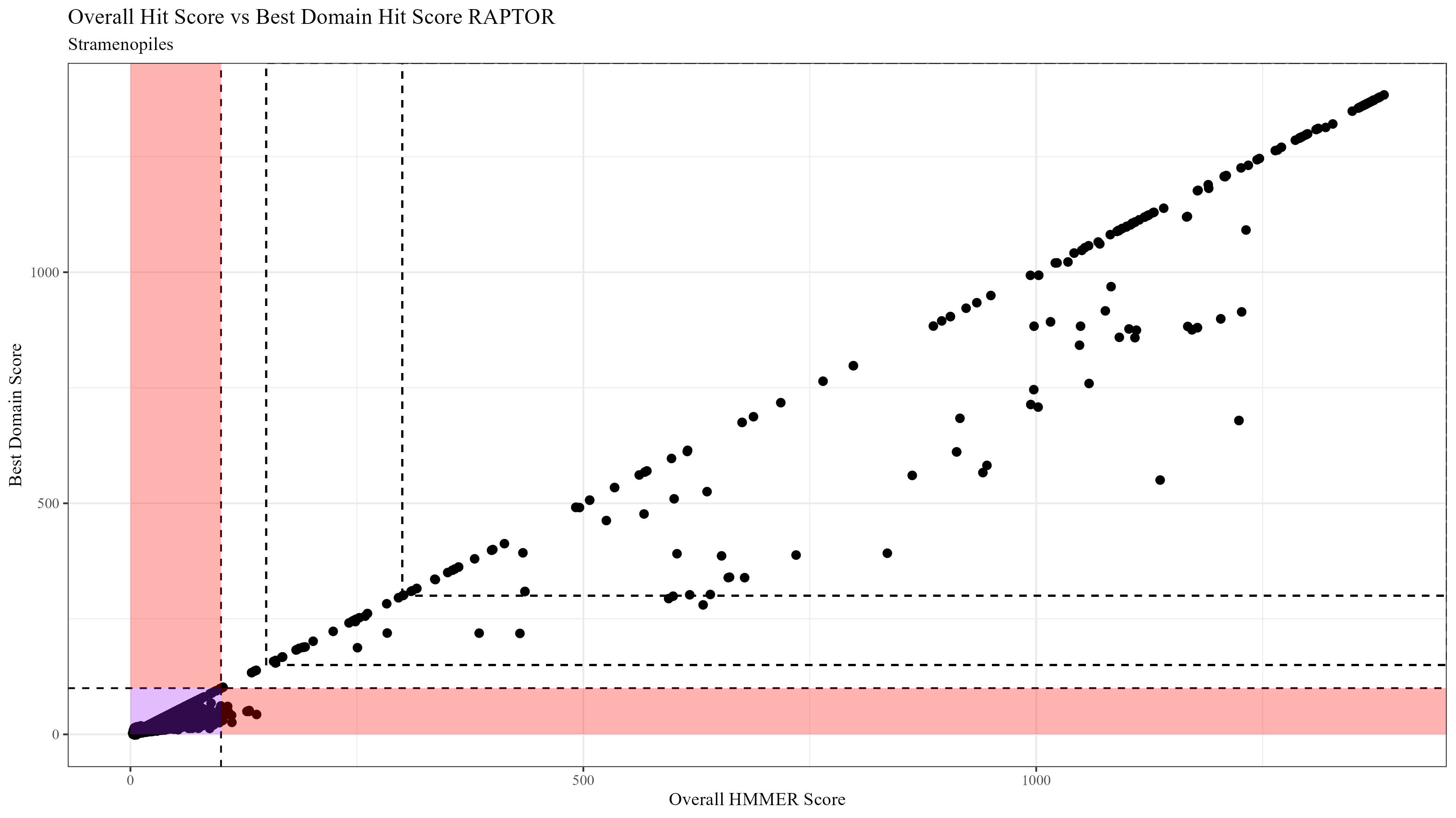
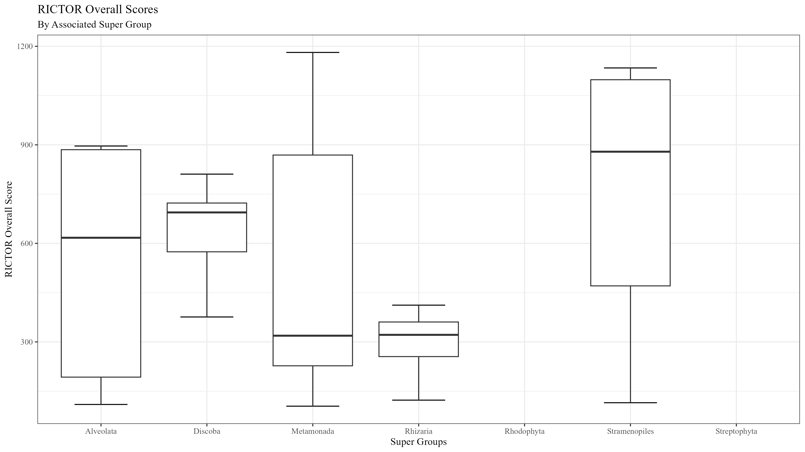
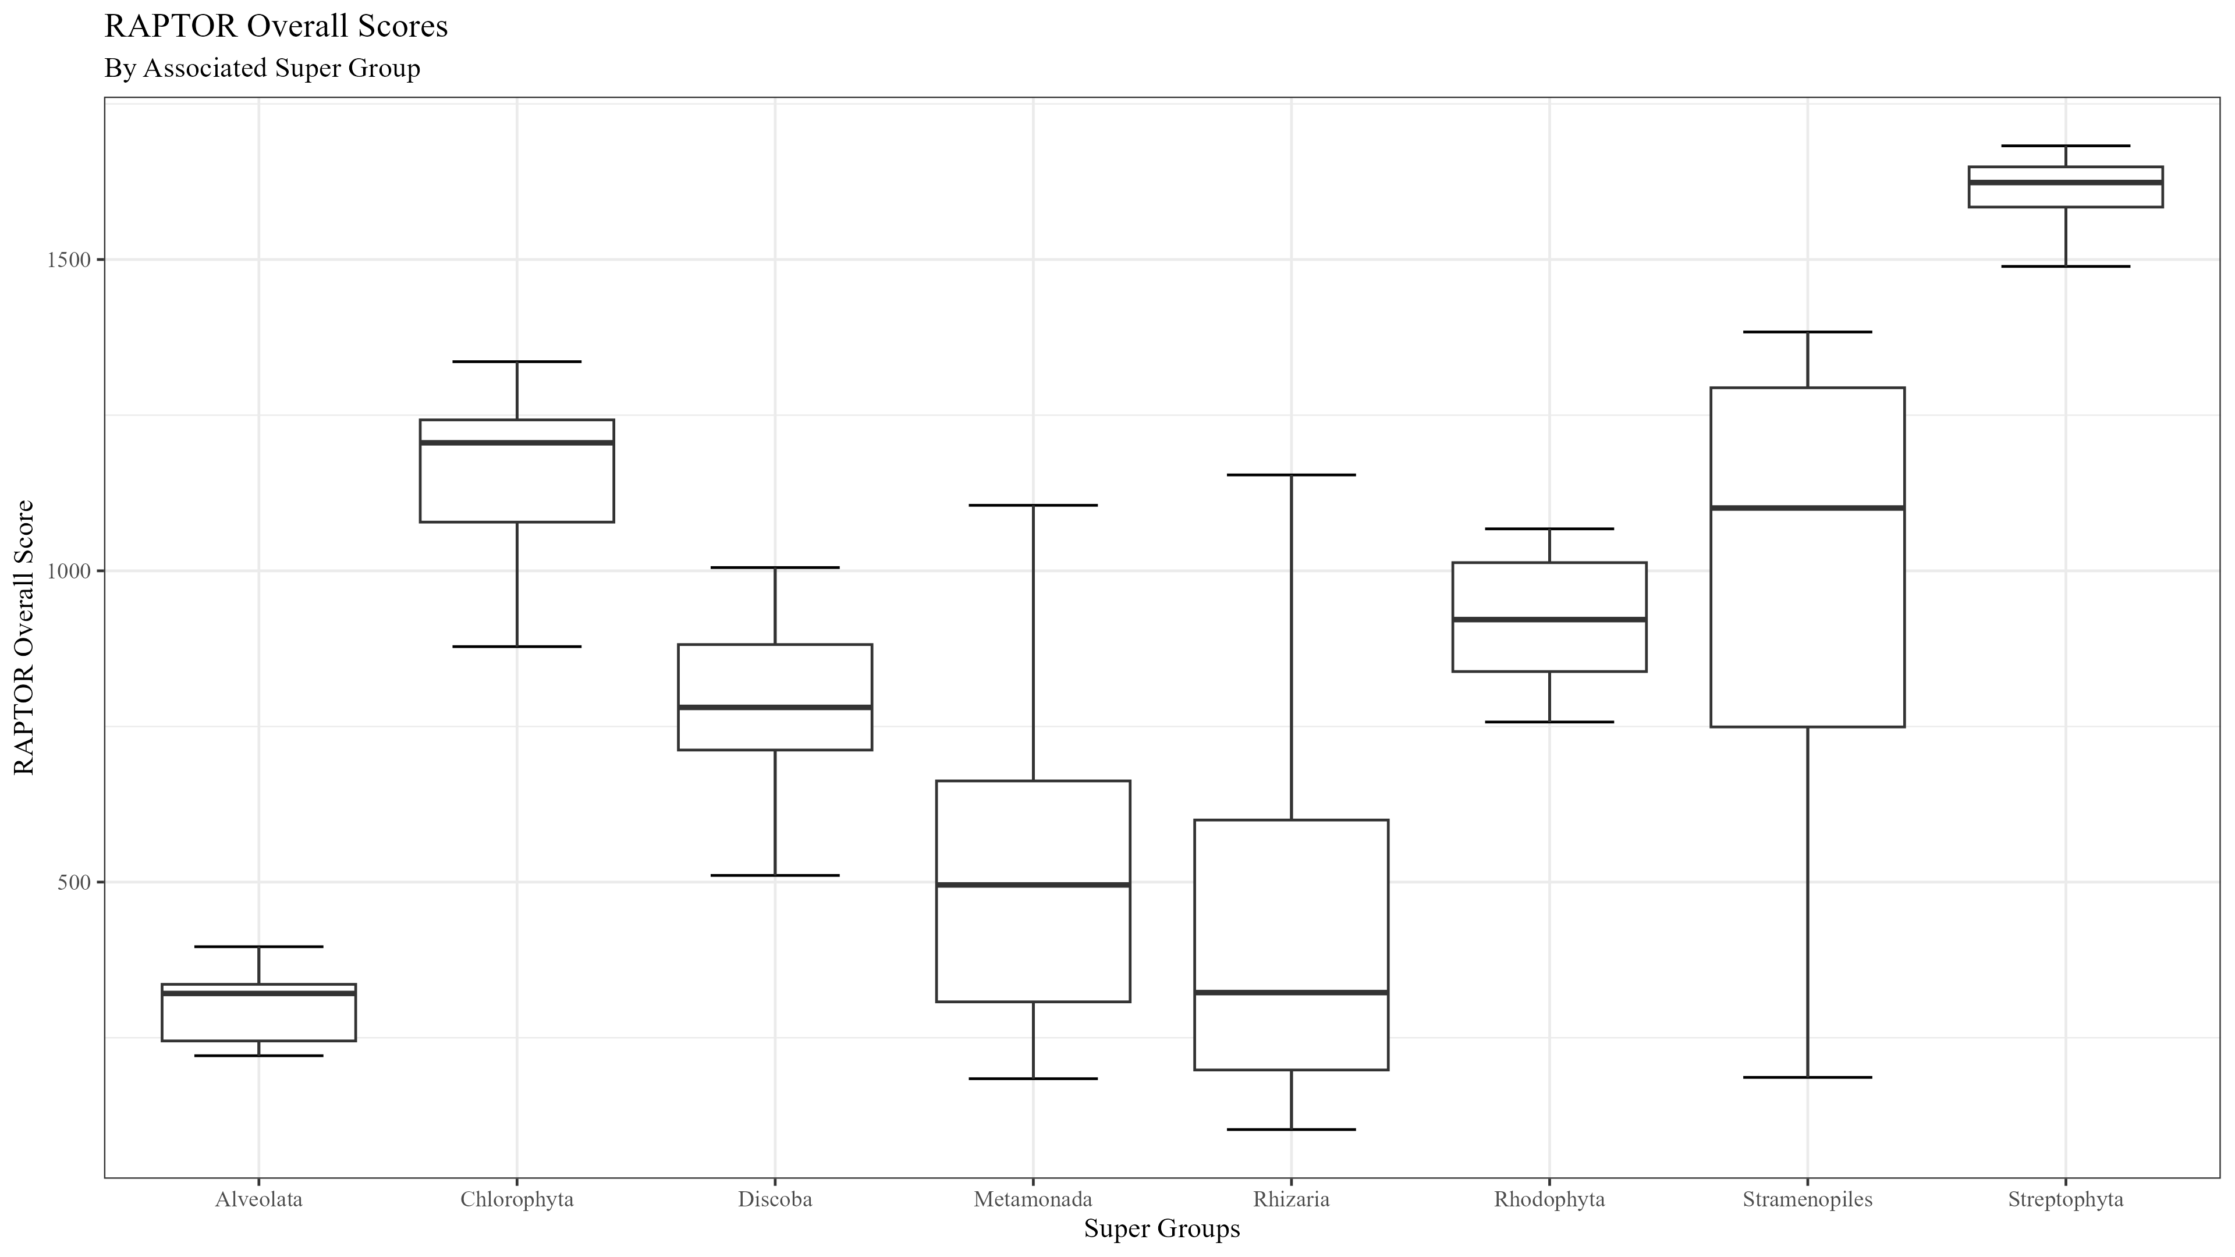
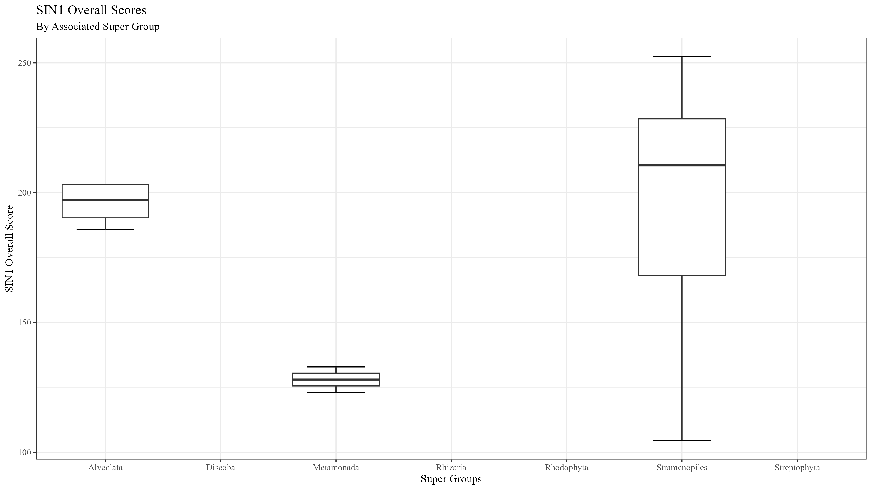
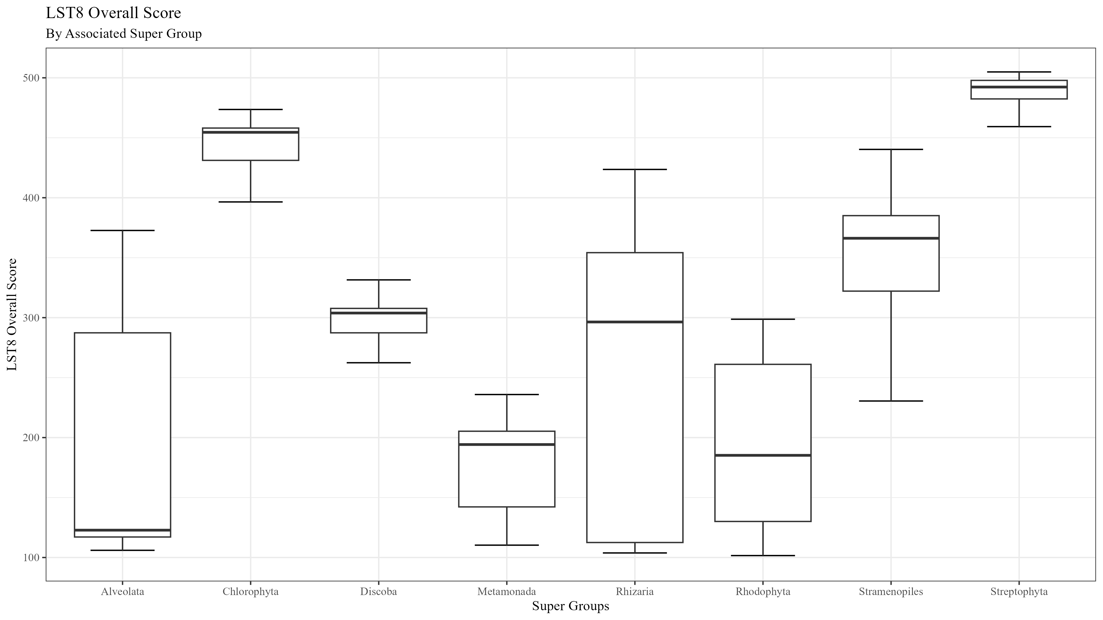

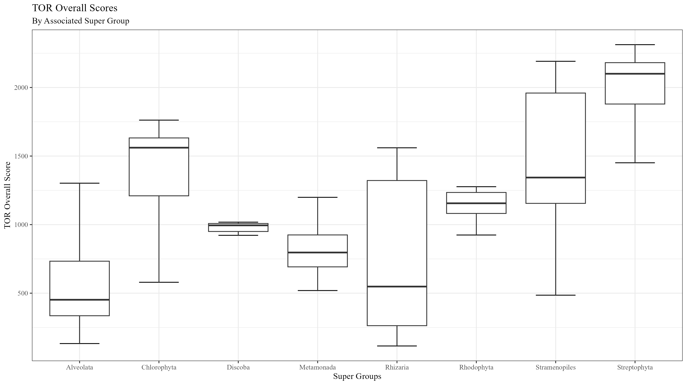
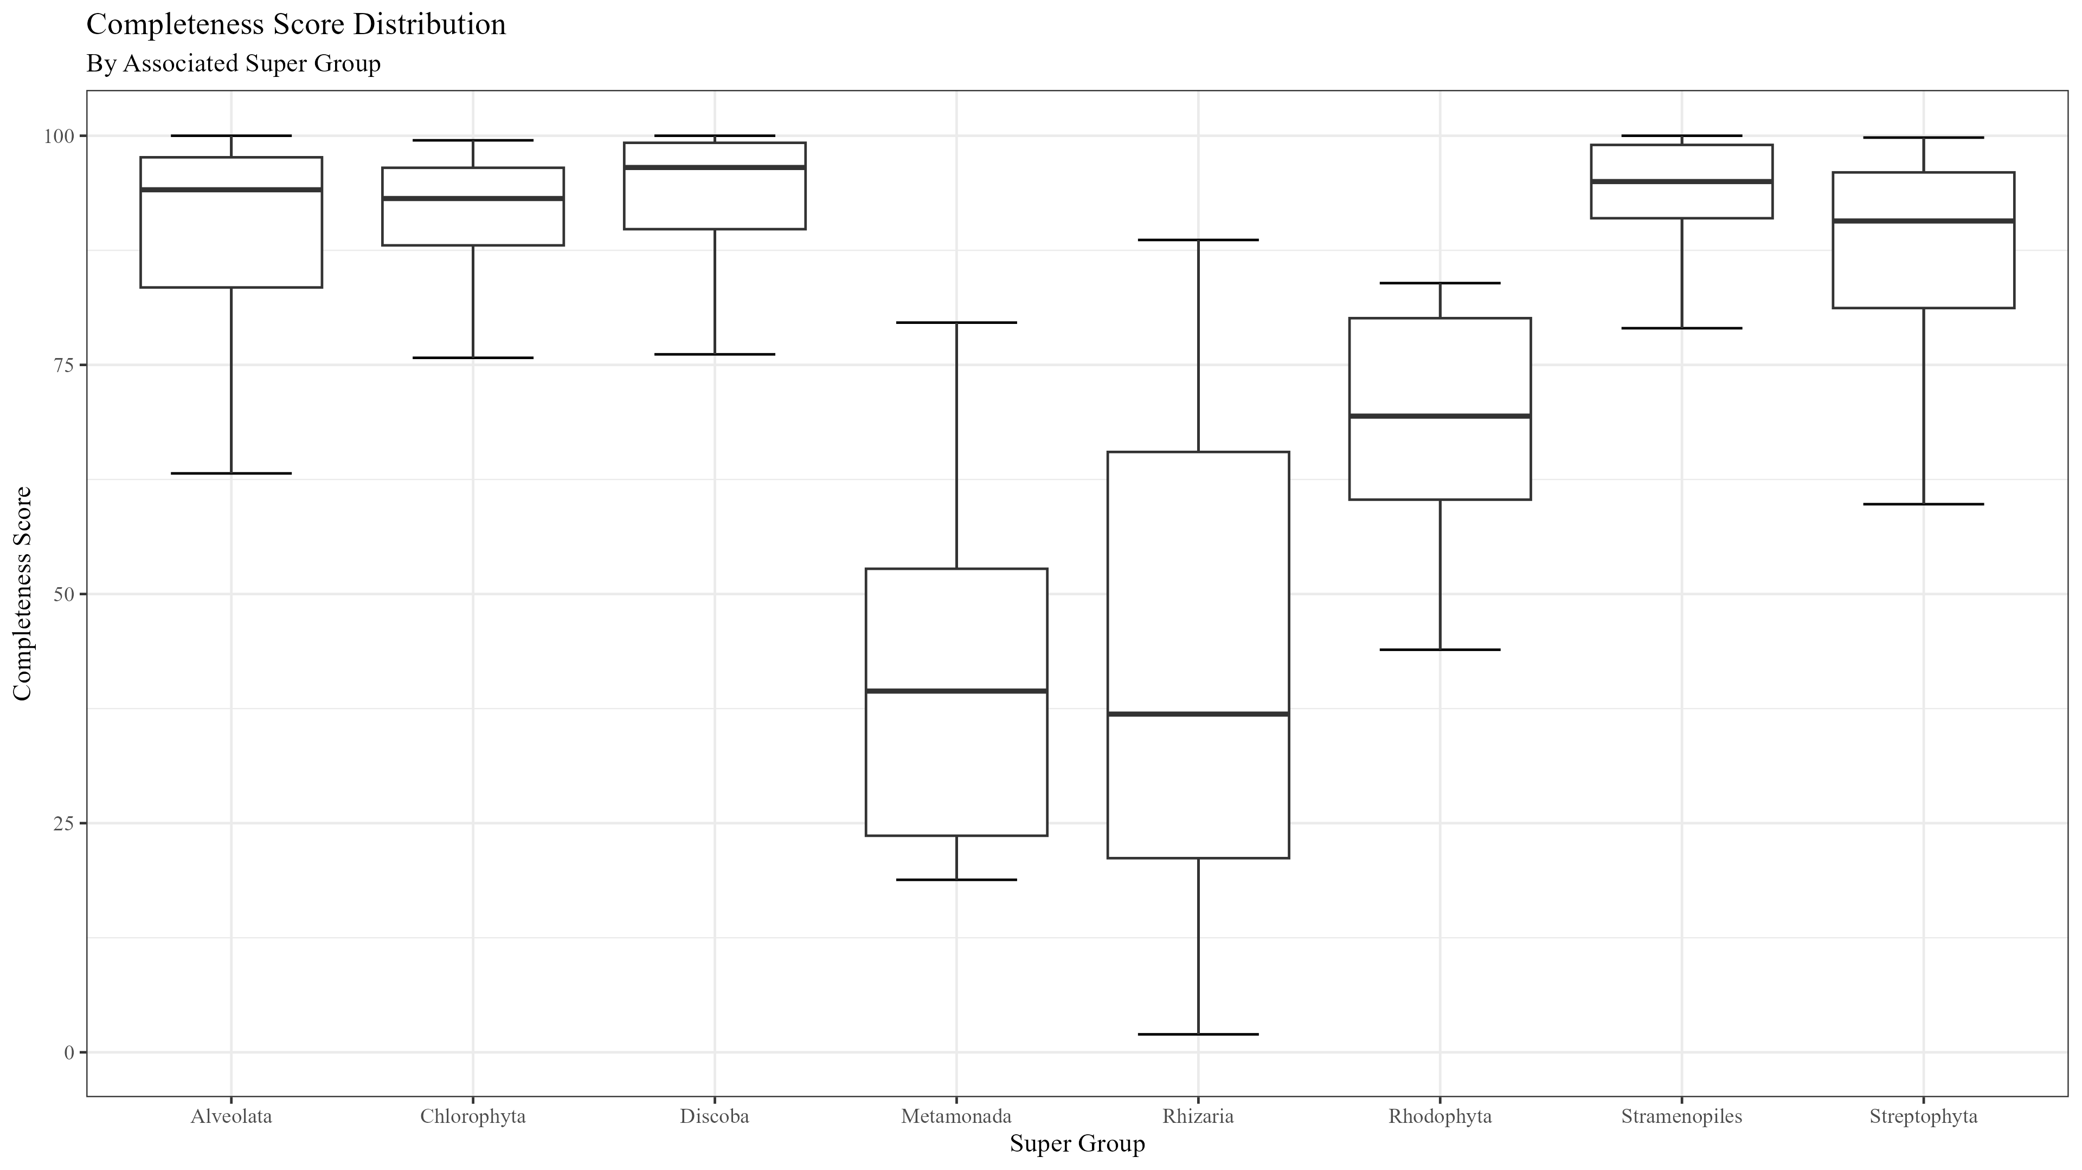
Figure 2

Slide 3
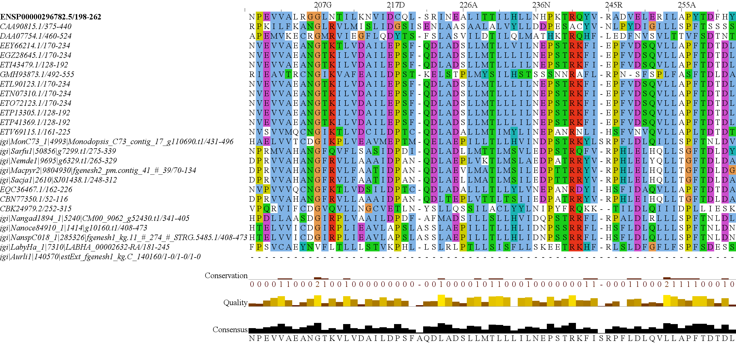
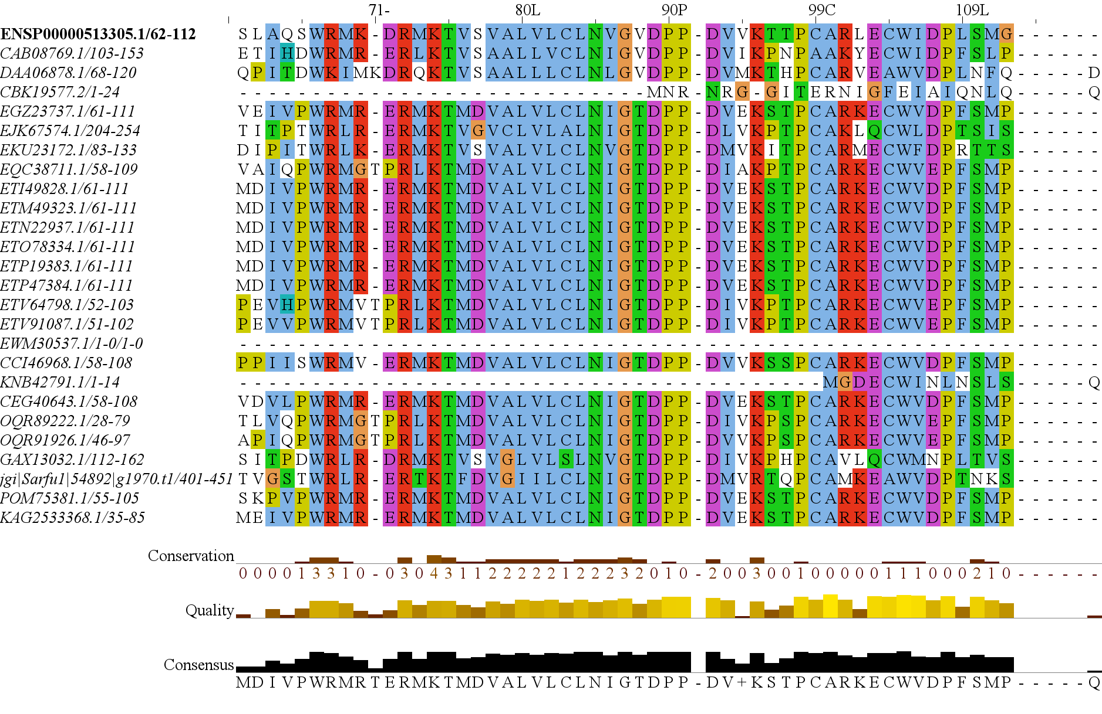
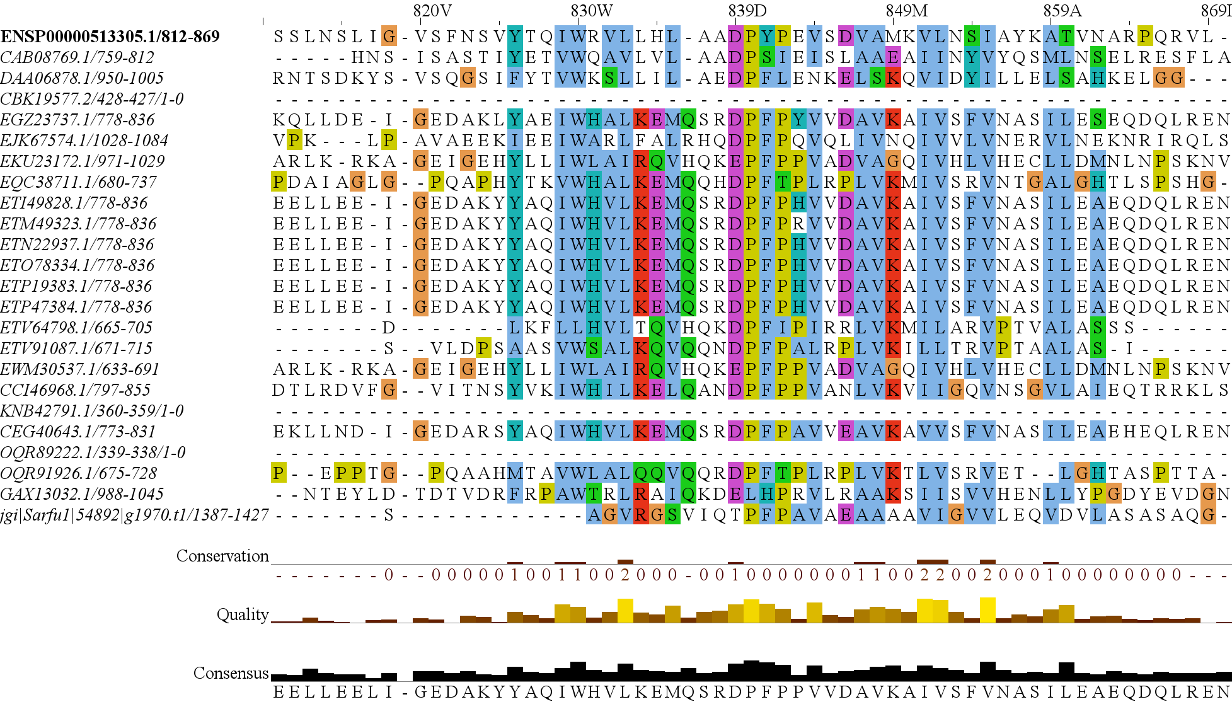
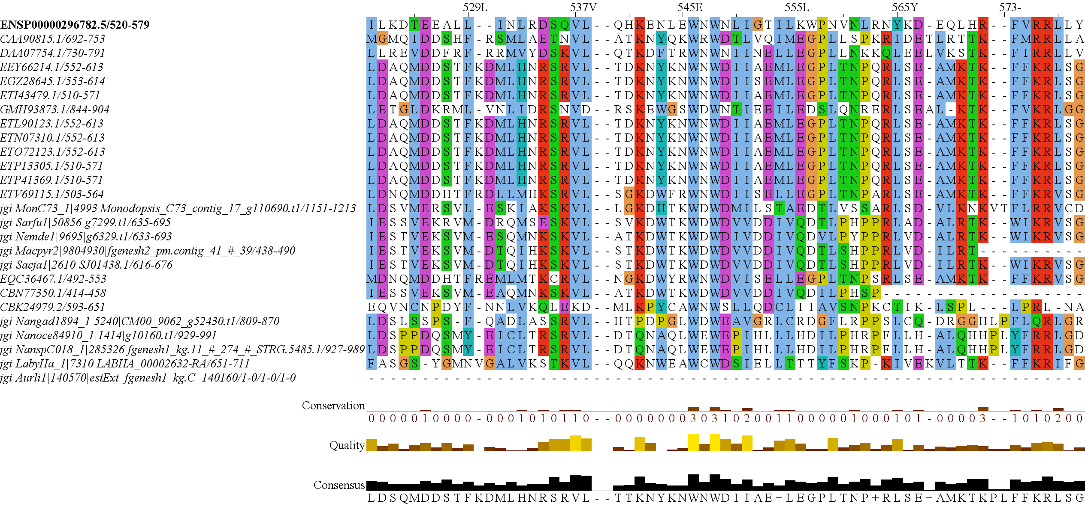
Figure 3
RICTOR
RAPTOR
N
N
RICTORN
RAPTORN
Reference
Reference
High
RICTORM
ARM
High
Medium
RasGEF
HEAT
Low
Medium
Dom5
ARM
Reference
Reference
RICTOR
Phosphorylation
WD-40
High
High
Medium
Medium
Low
C
C

Slide 4
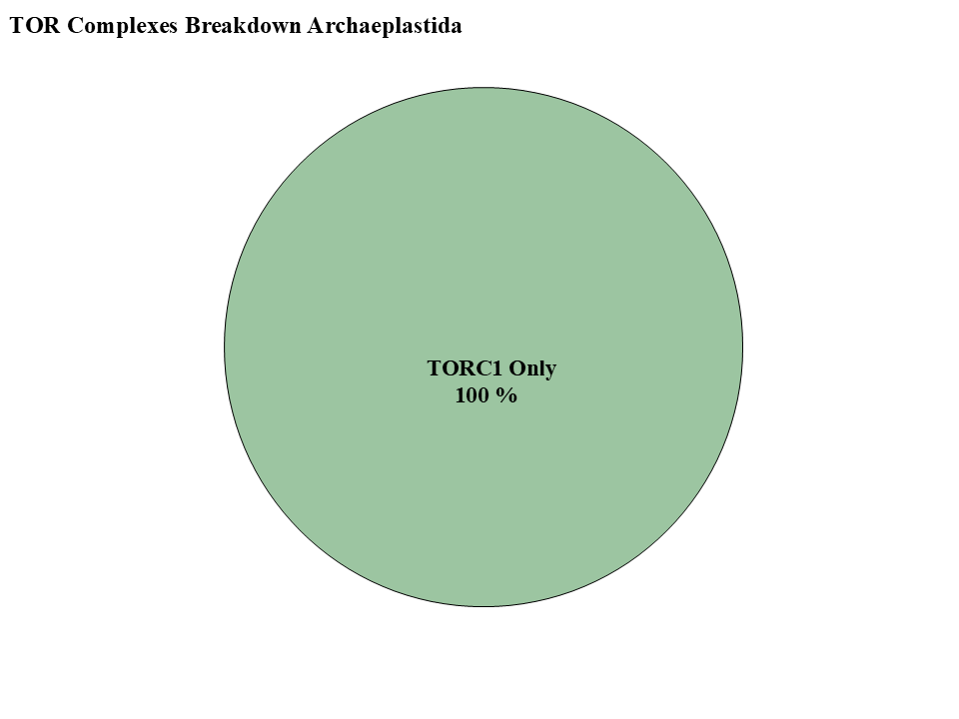
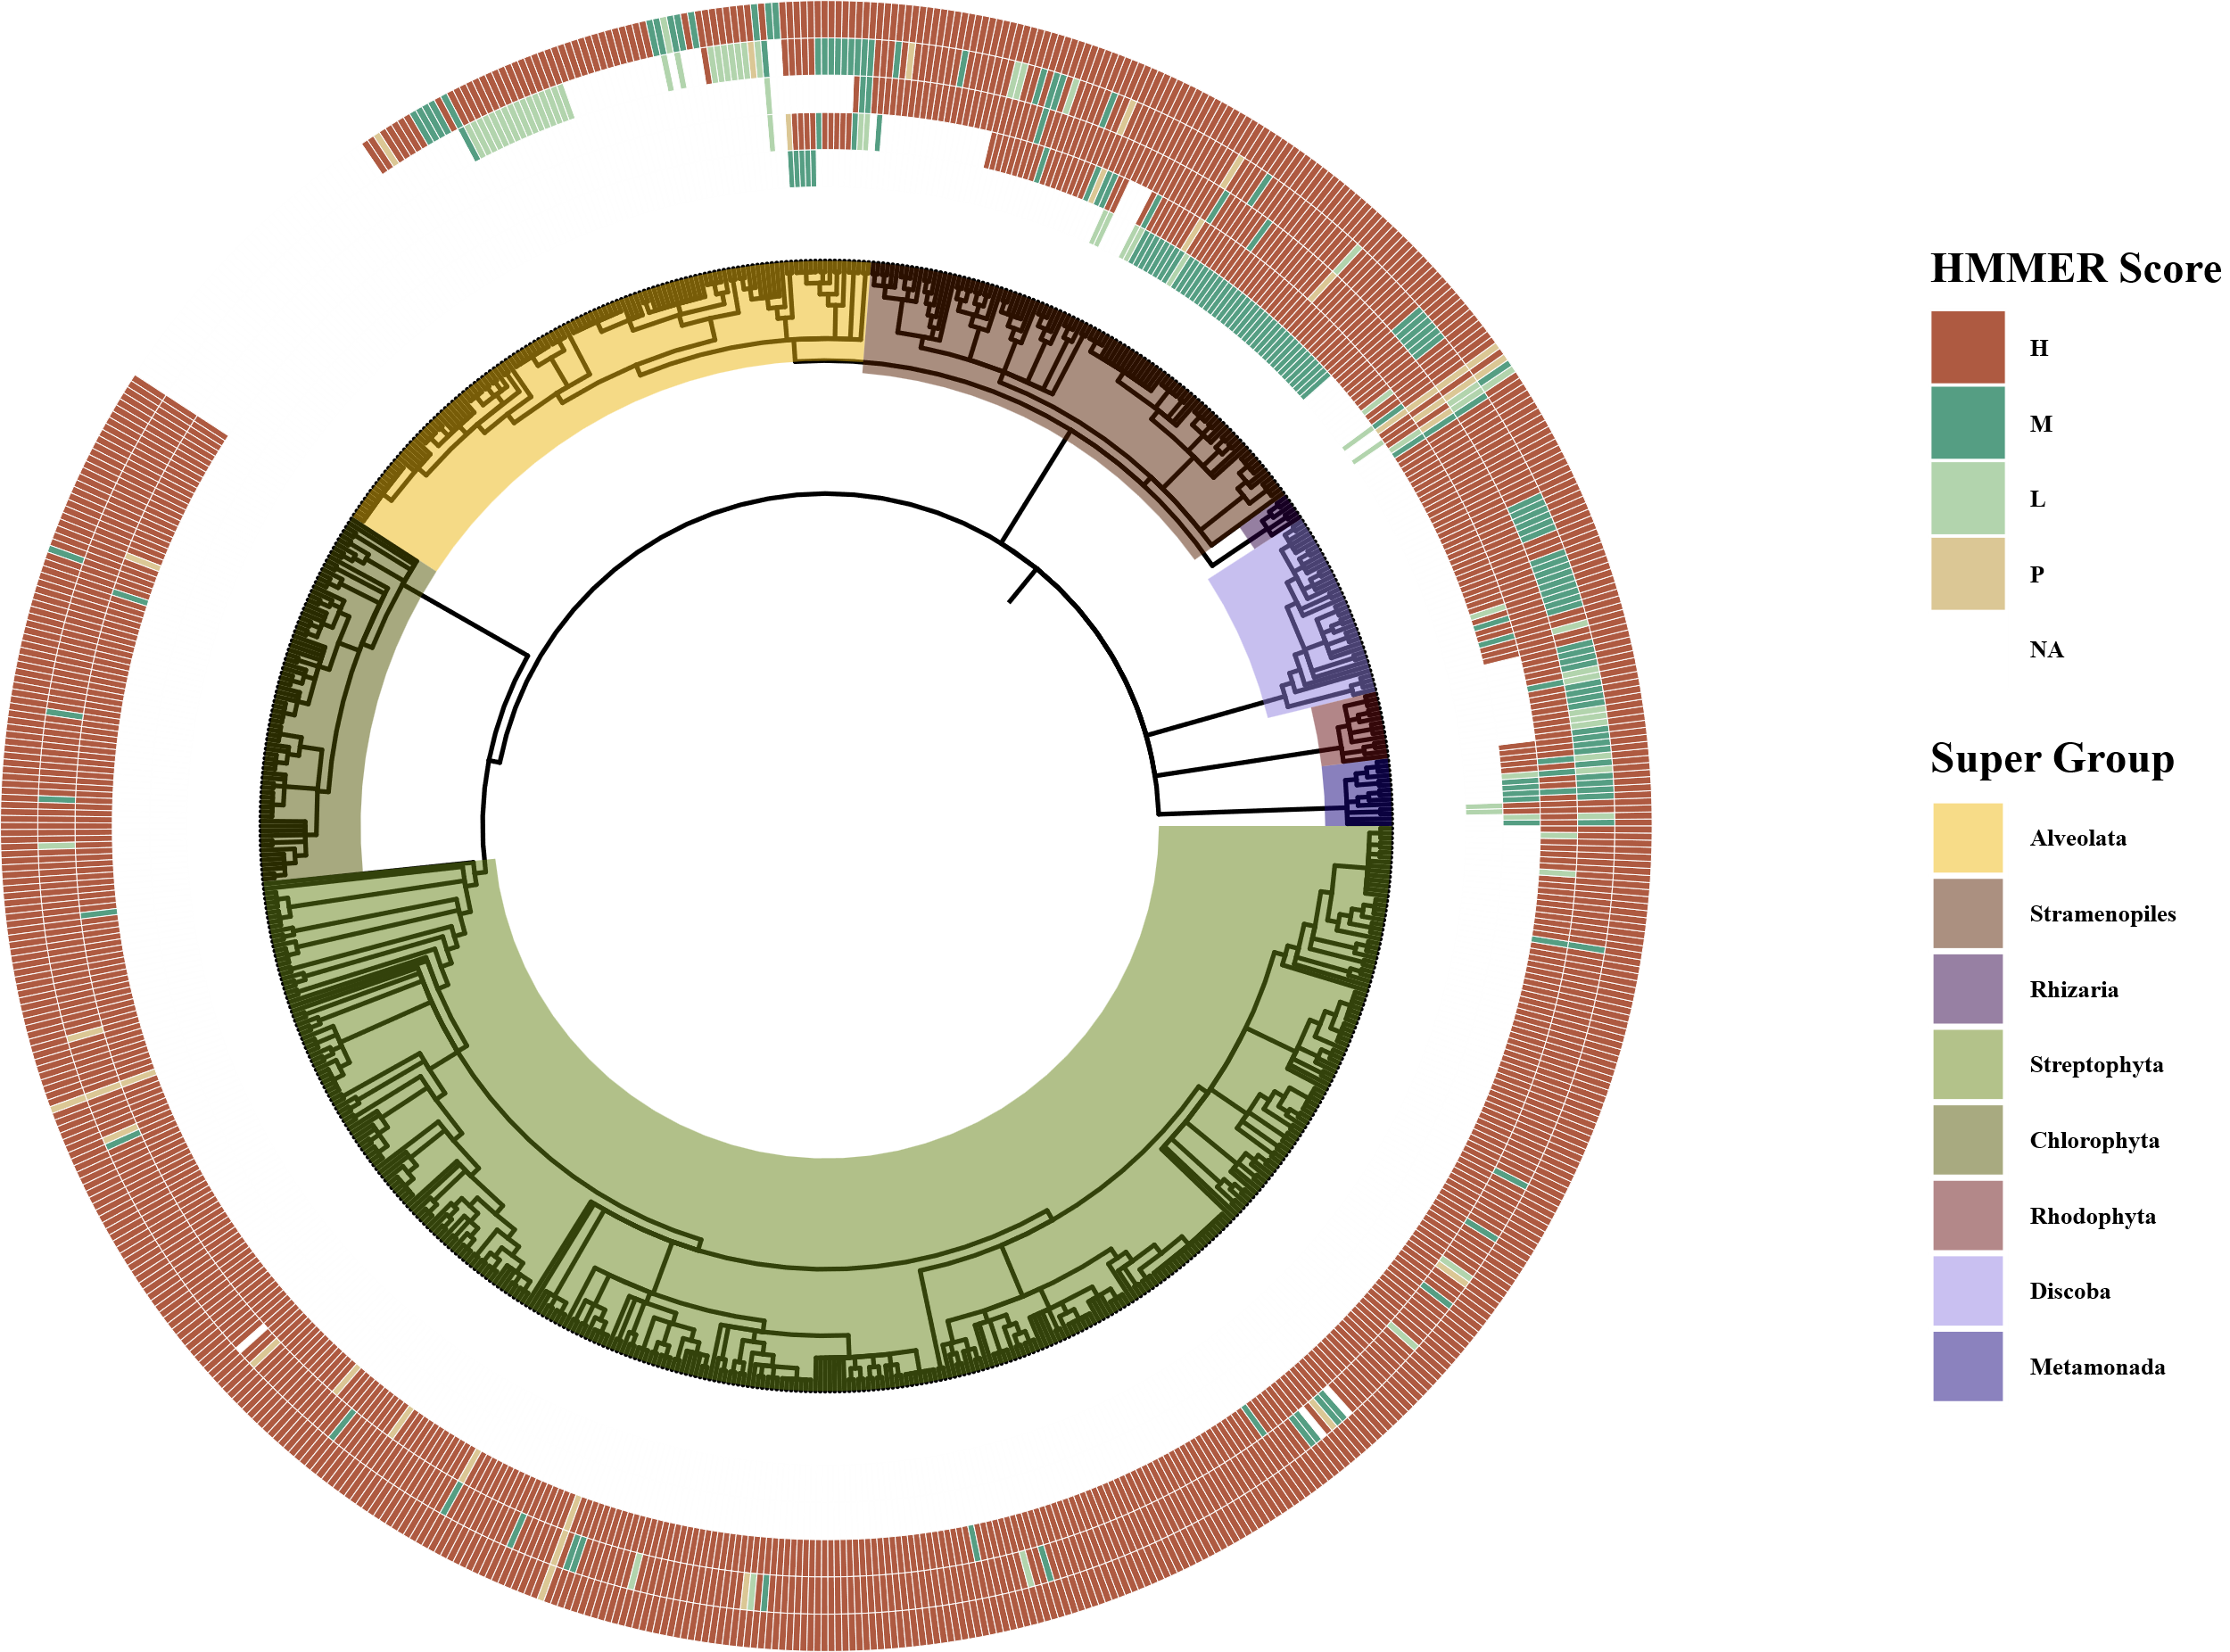
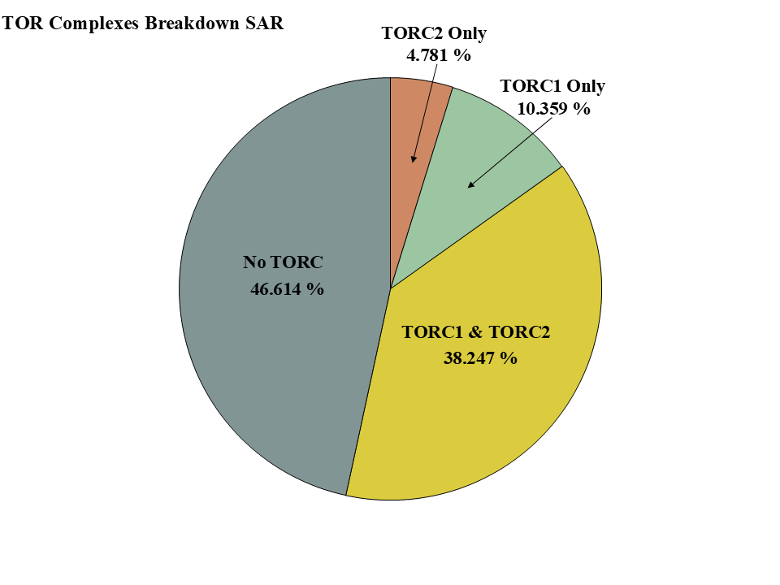
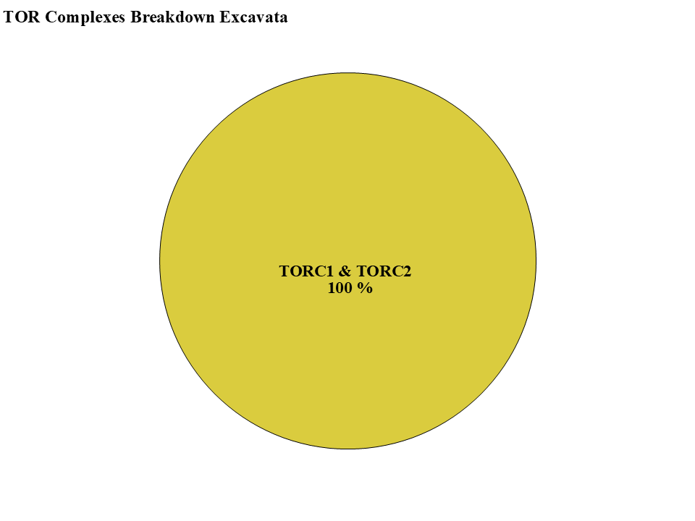
-TOR-
-LST8-
-RAPTOR-
-RICTOR-
-SIN1-

Slide 5
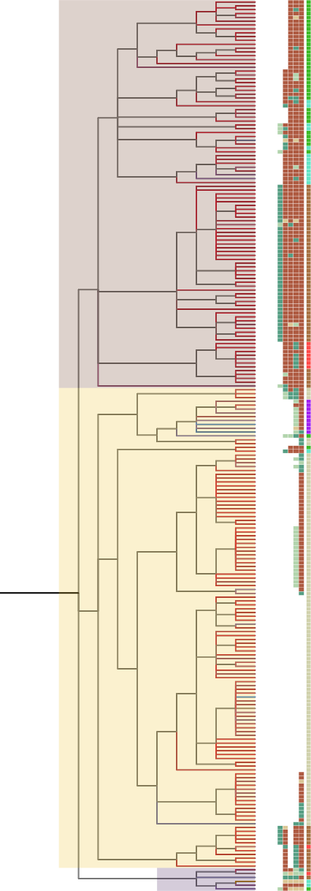
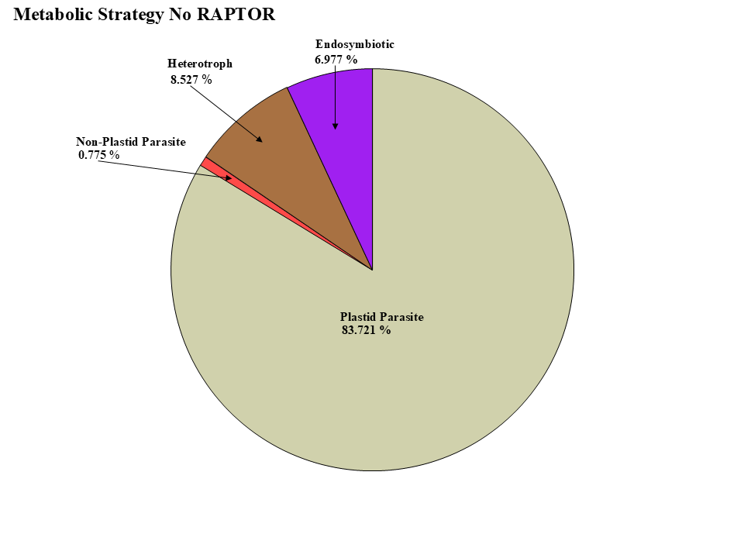
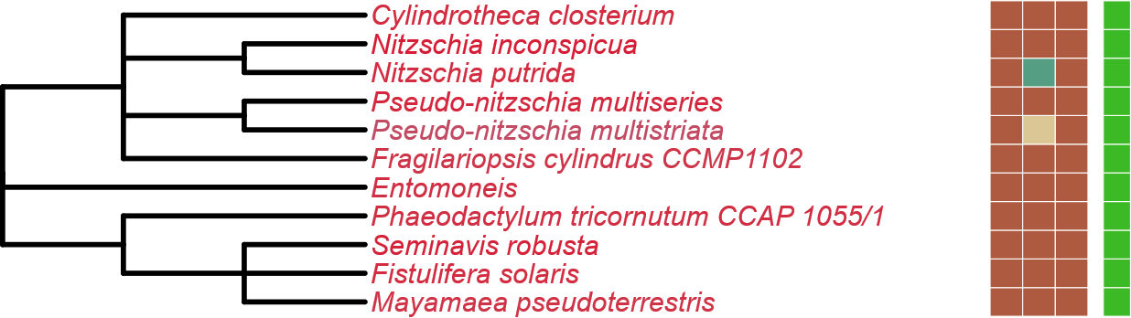
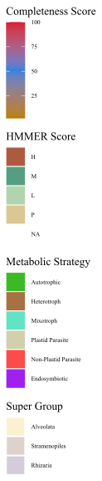
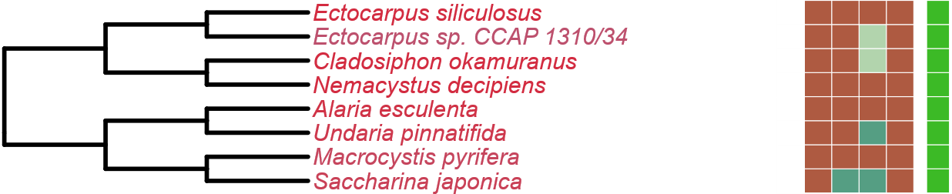
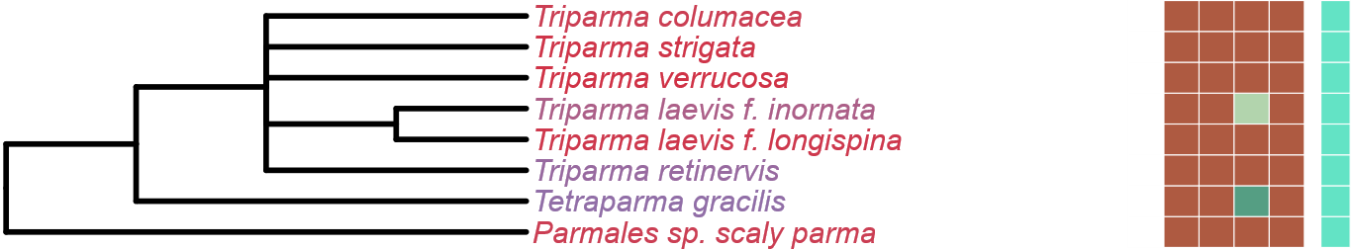
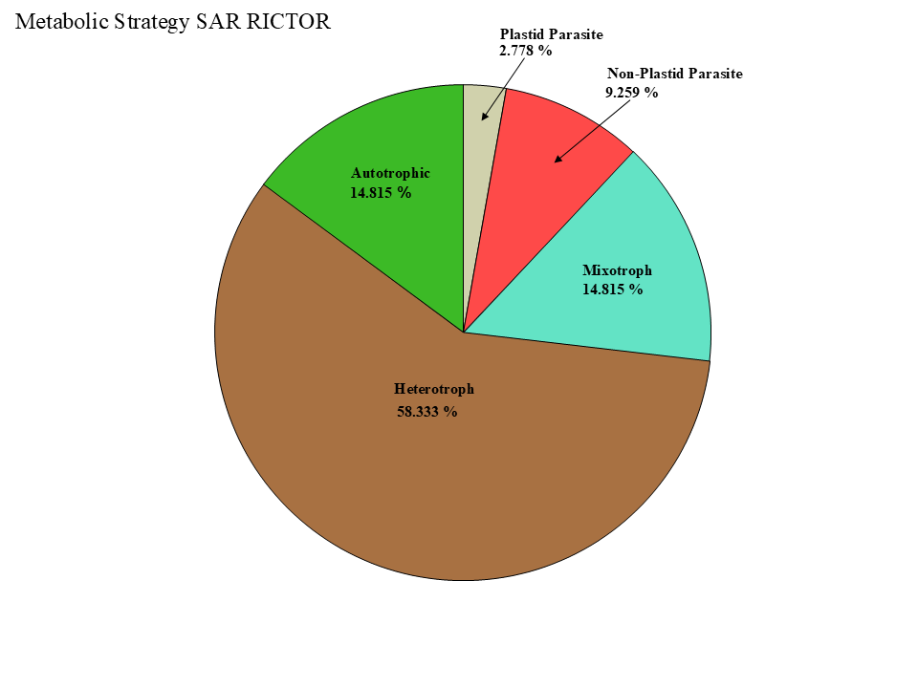
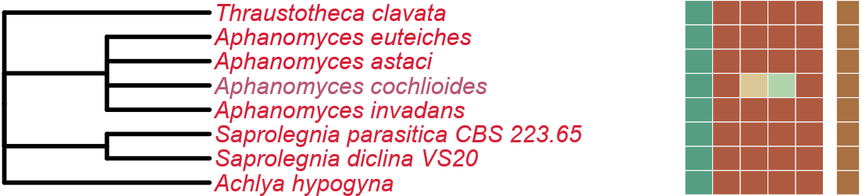
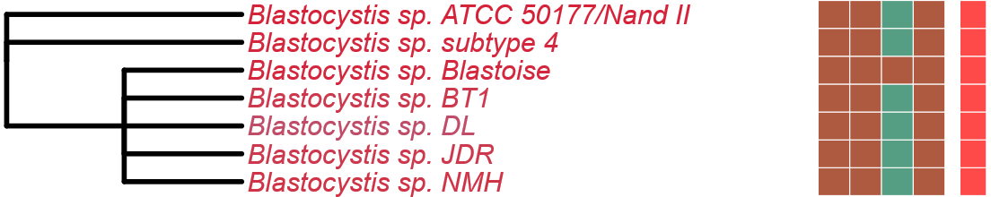
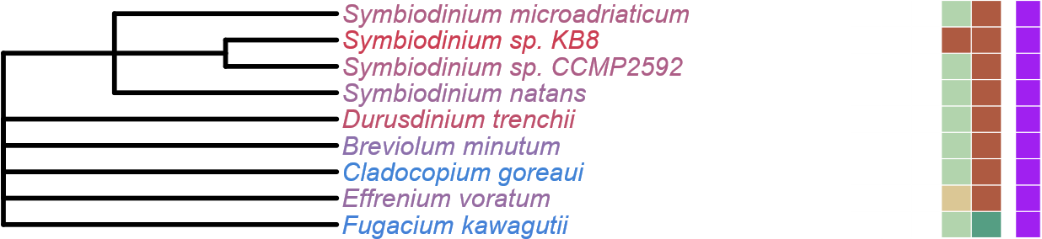
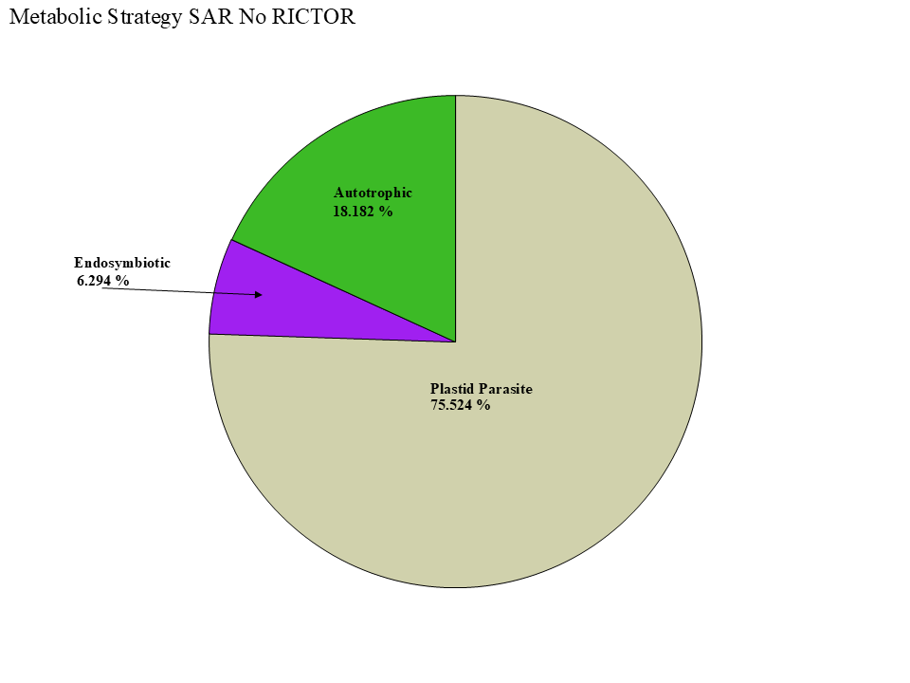
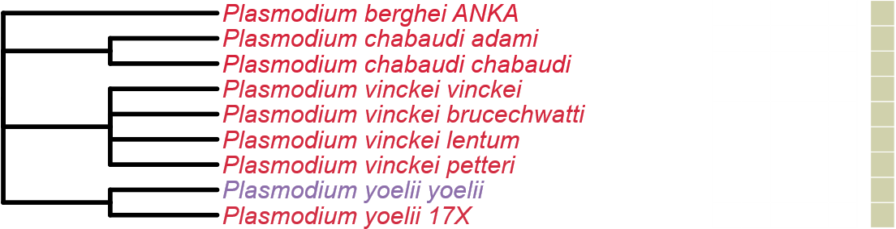
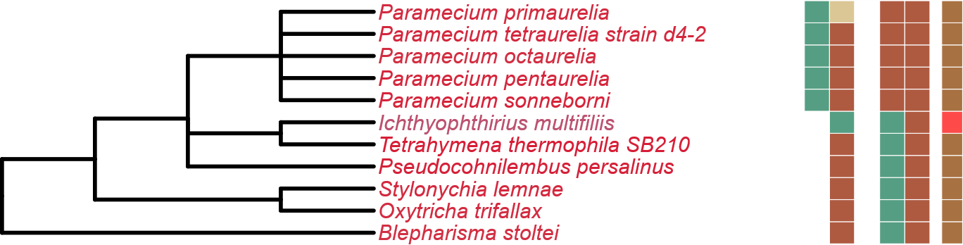
Figure 4
LST8
RICTOR
RAPTOR
SIN1
TOR
Stramenopiles
Alveolata
Rhizaria

Slide 6
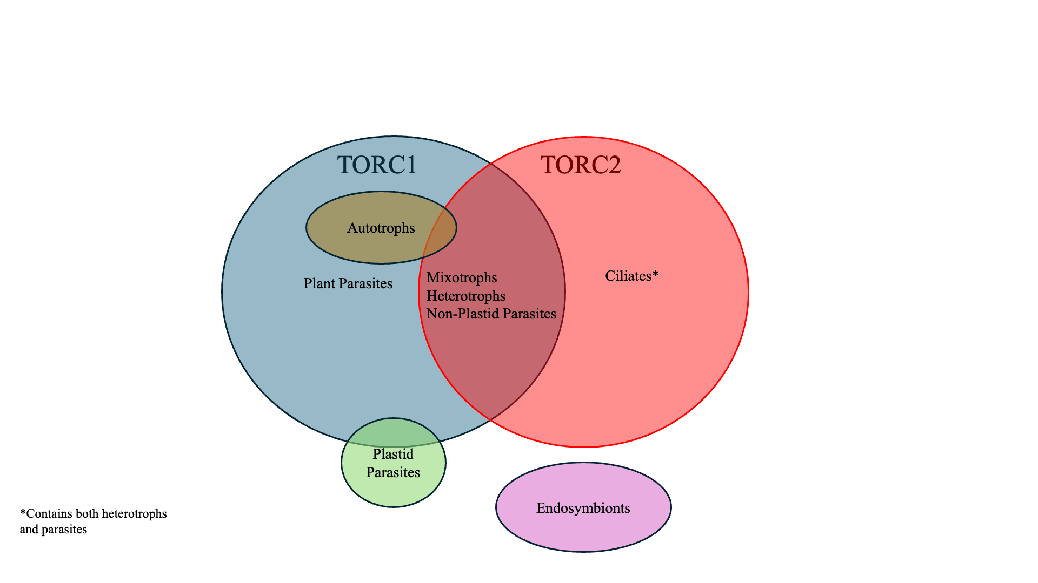

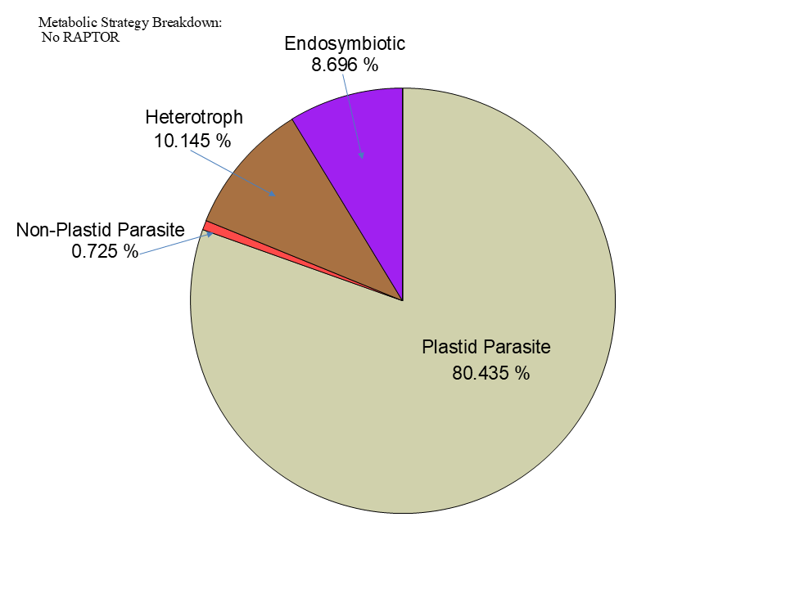

Figure 5

Slide 7
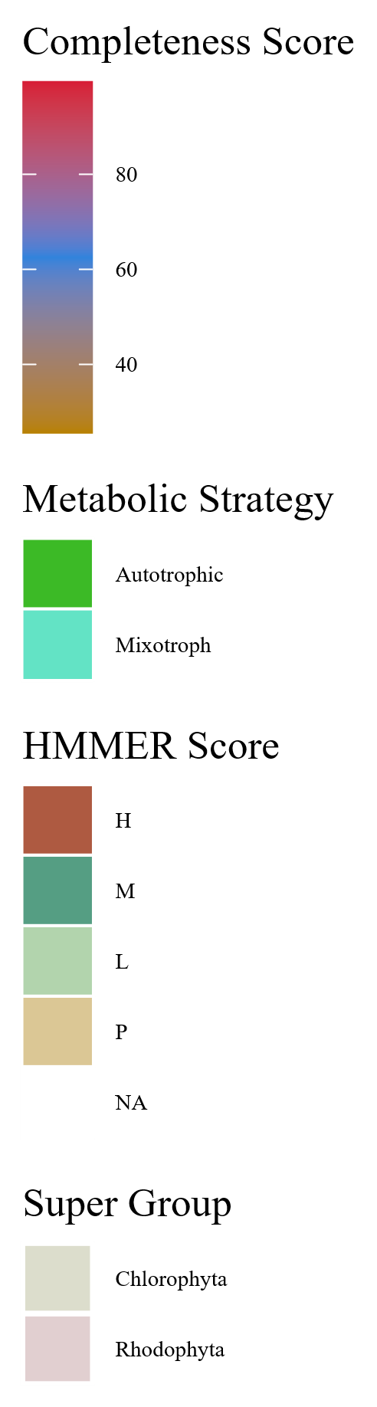
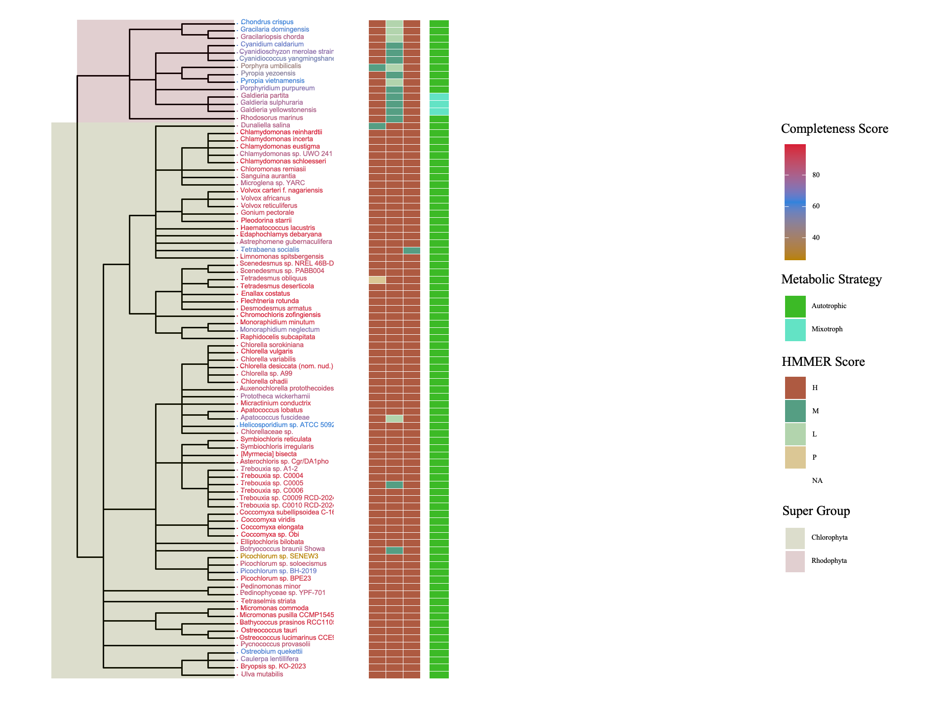
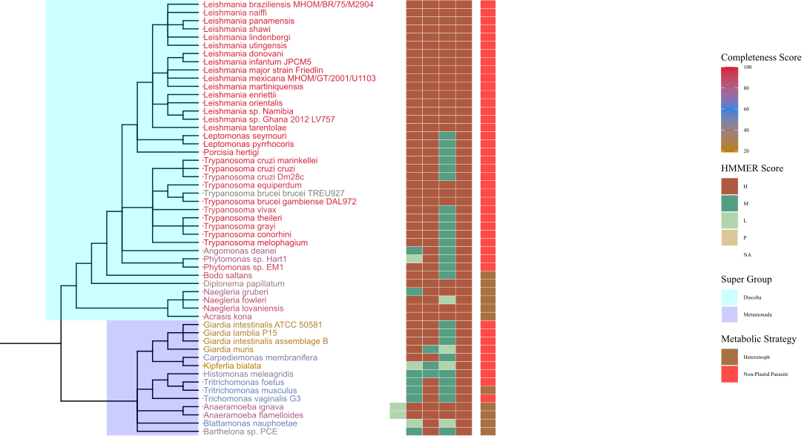
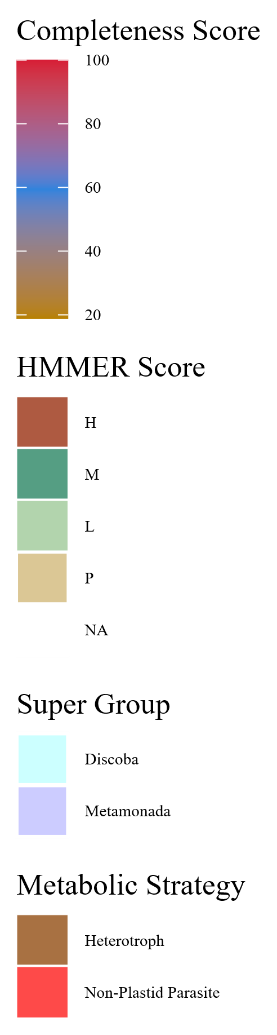
Figure 7
Metabolic Strategy
Metabolic Strategy
SIN1
RICTOR
LST8
RAPTOR
SIN1
TOR
RICTOR
RAPTOR
LST8
TOR
Rhodophyta
Discoba
Chlorophyta
Metamonada

Slide 8
Figure 7
Metabolic Strategy
SIN1
RICTOR
RAPTOR
LST8
TOR
Discoba
Metamonada

Slide 9
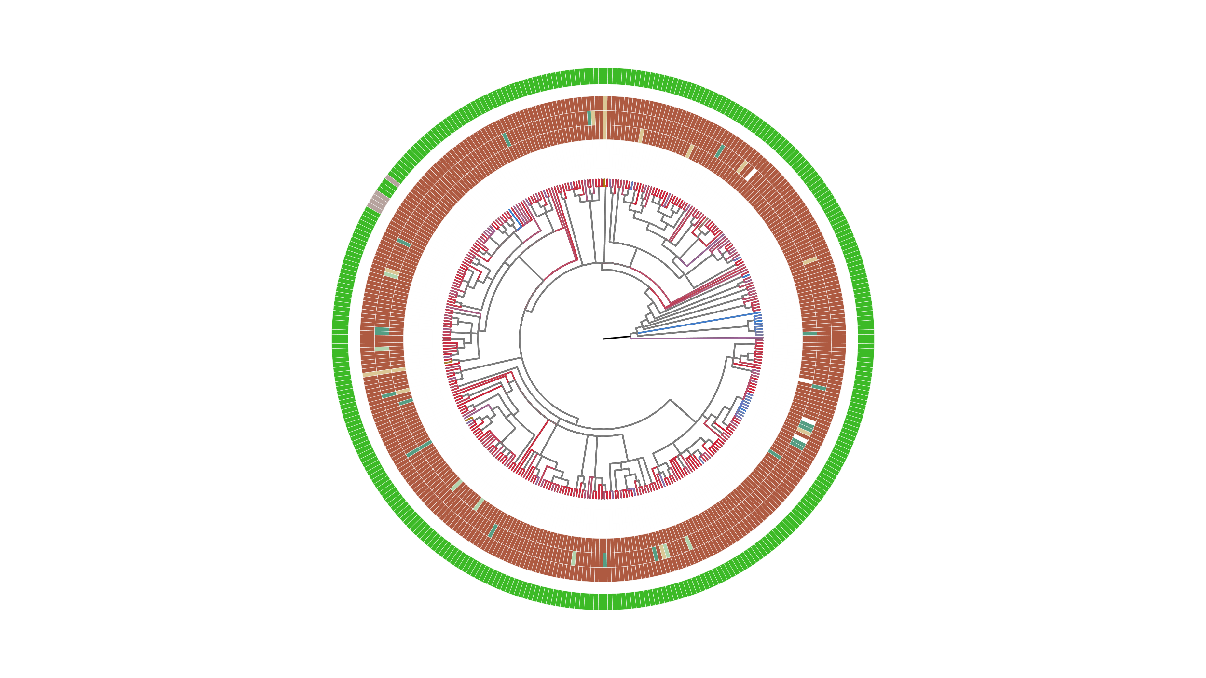
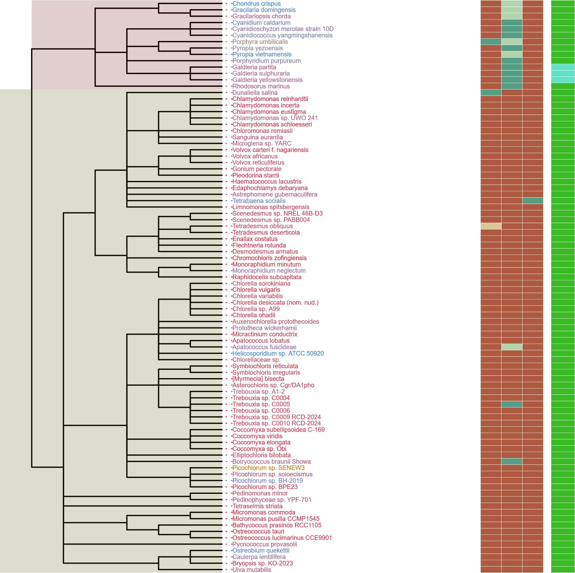
Metabolic Strategy
SIN1
RICTOR
RAPTOR
LST8
TOR
Streptophyta
Rhodophyta
Chlorophyta

Slide 10
ARCHIVED BELOW

Slide 11
Figure 1
MSA
Phylogenetic Tree(s)
Final Images,
Pattern Loss Detection
Genome information from NCBI/JGI
BUSCO/HMMER/BLAST
Combined Dataframes
Graphs/Plots/Tables
Trophic Strategy from literature
SRA/DIAMOND

Slide 12
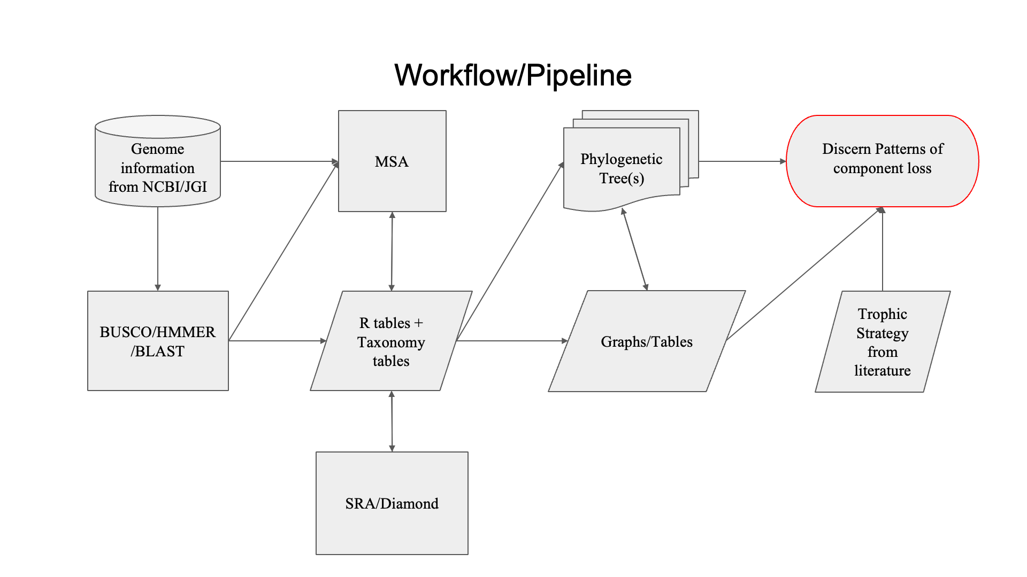
Figure 1

Slide 13
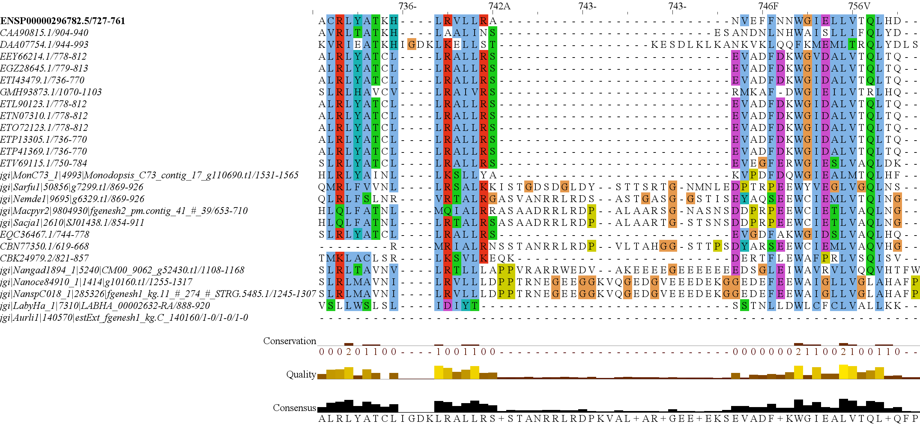
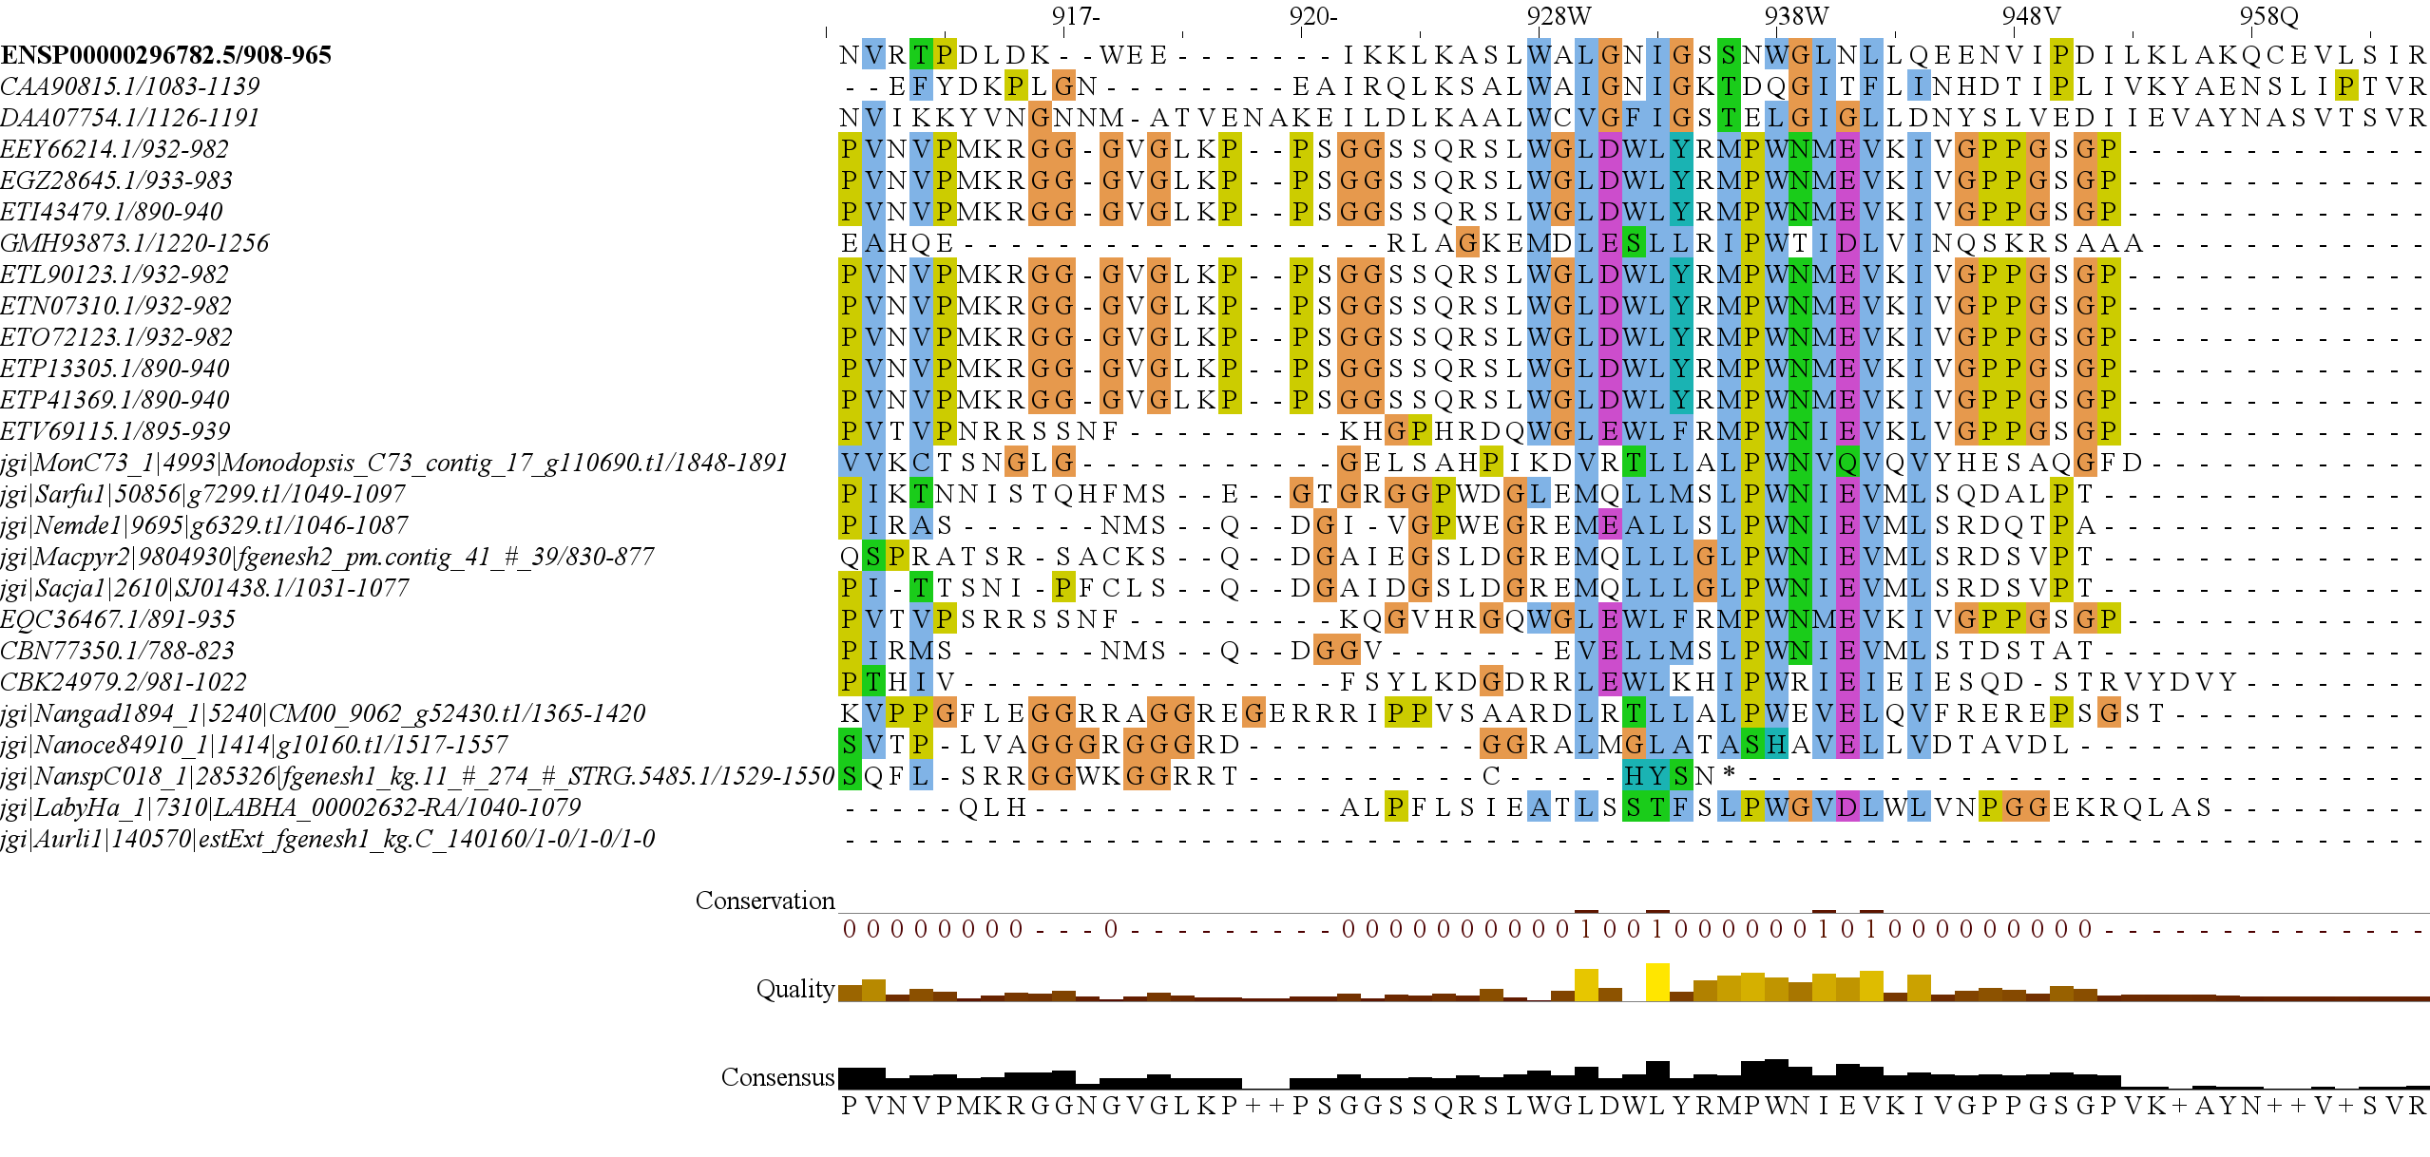
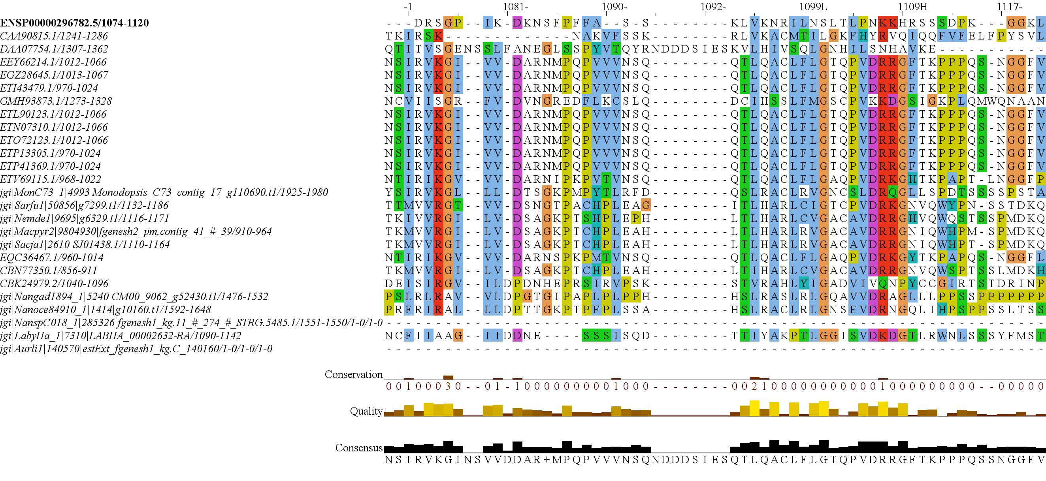
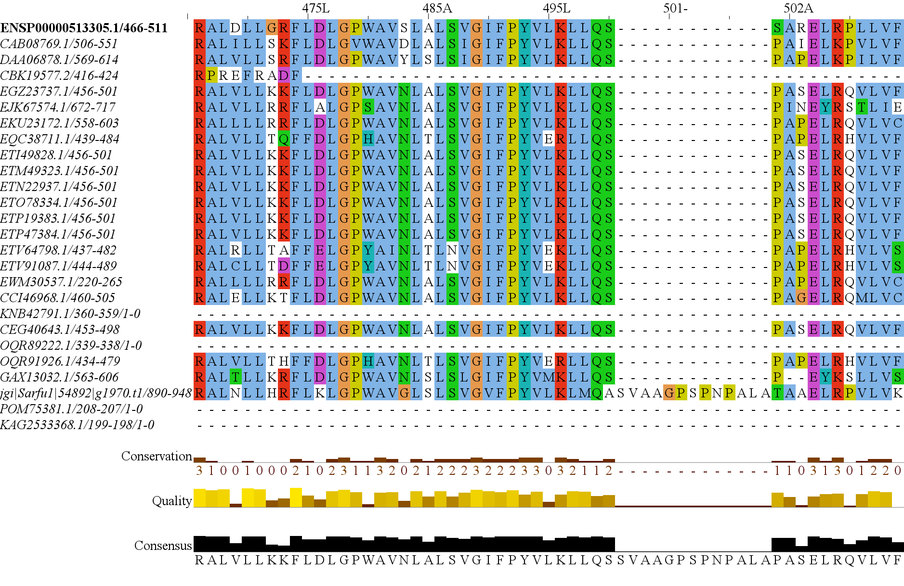
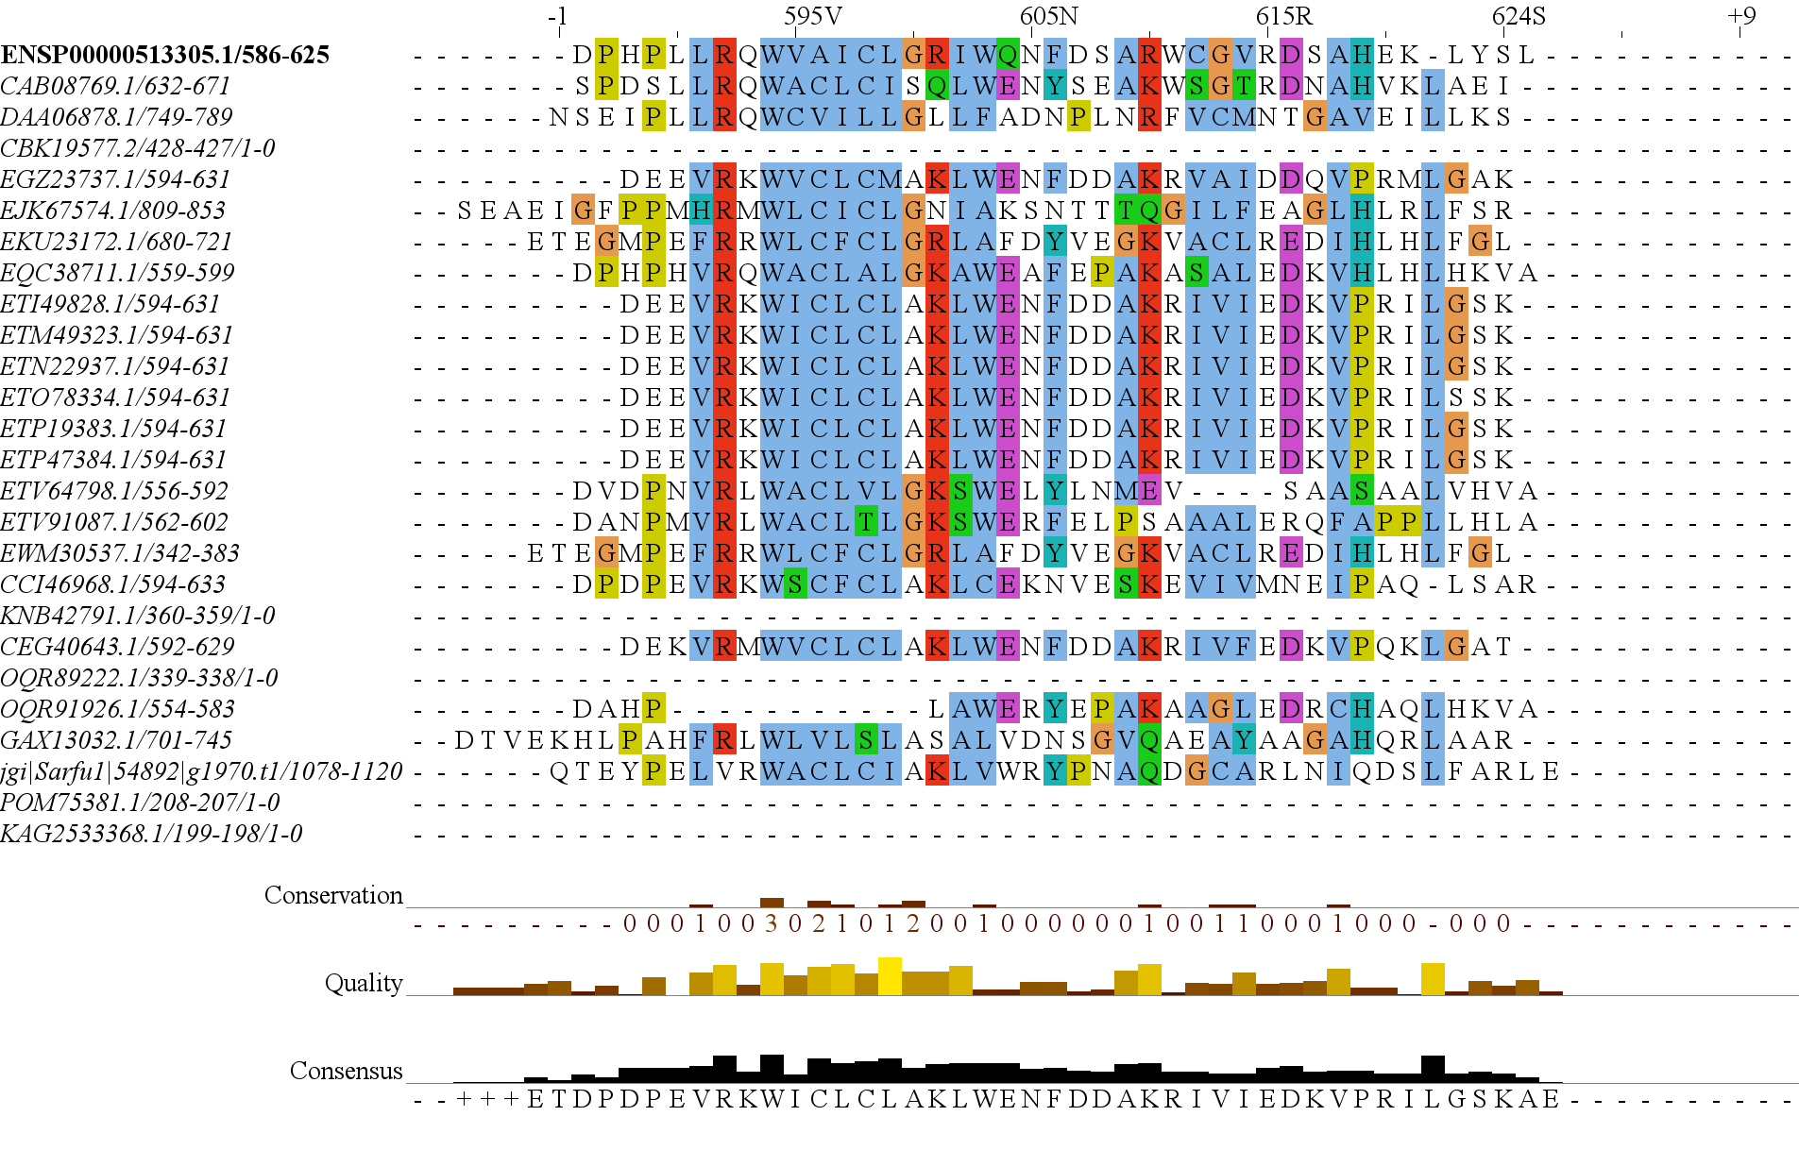
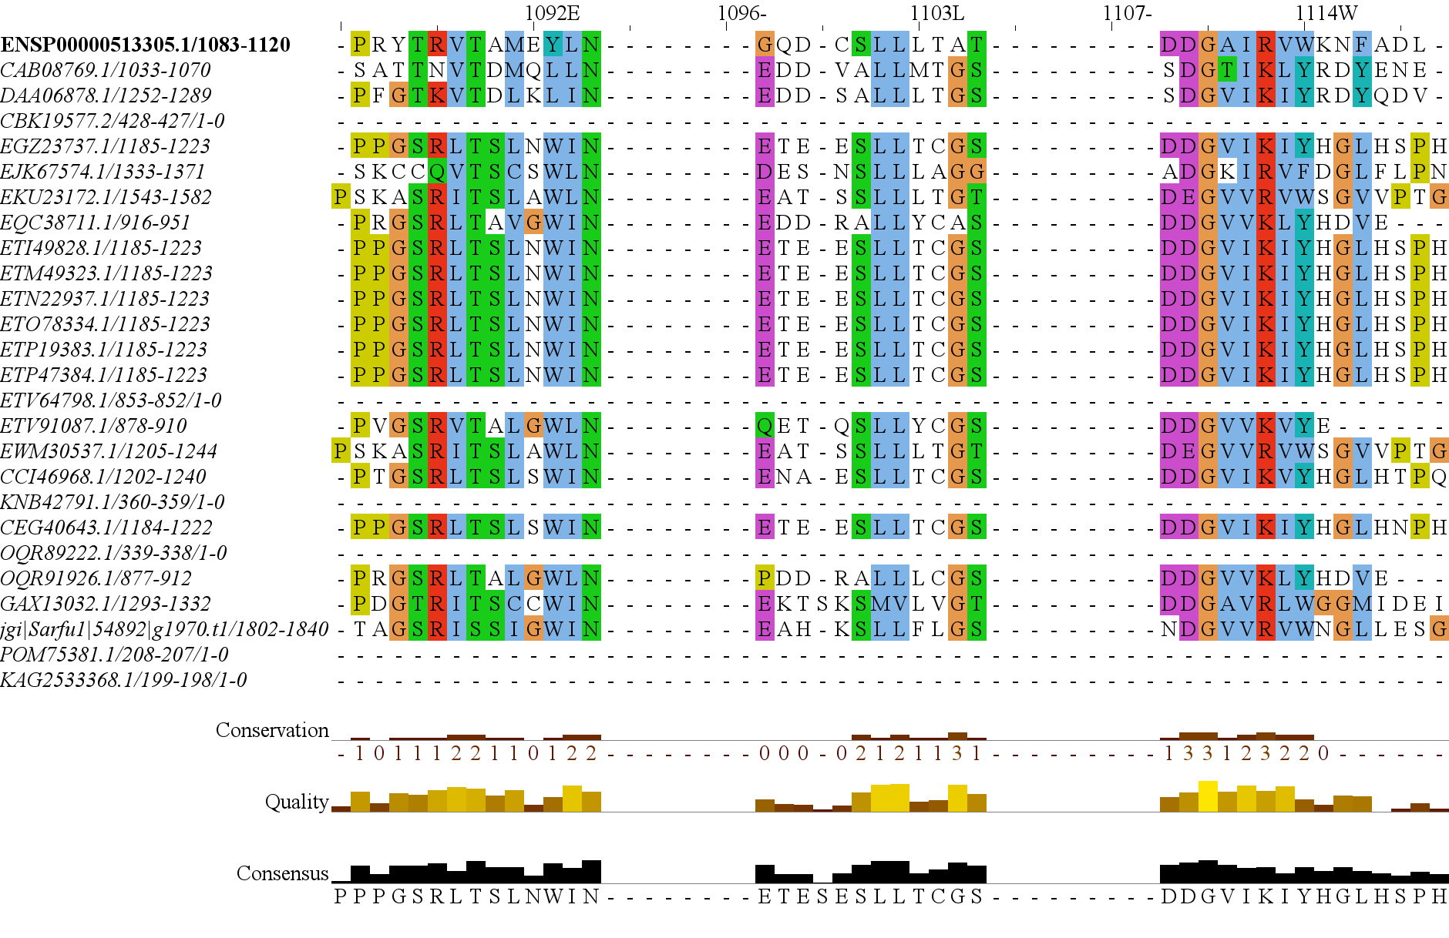
Figure 3
1
RasGEF
Domain5
1694
RICTORN
RICTORM
RICTOR Phosphorylation
Reference
High
Medium
Low
1
HEAT
ARM Repeats
1353
RAPTORN
ARM Repeats
WD-40 Repeats
Reference
High
Medium

Slide 14
Figure 3
1
1694
RICTORN
RICTORM
RasGEF
Domain5
RICTOR Phosphorylation
ARM Repeats
Reference
High
Medium
Low
1
1353
RAPTORN
ARM Repeats
HEAT
ARM Repeats
WD-40 Repeats
Reference
High
Medium

Slide 15
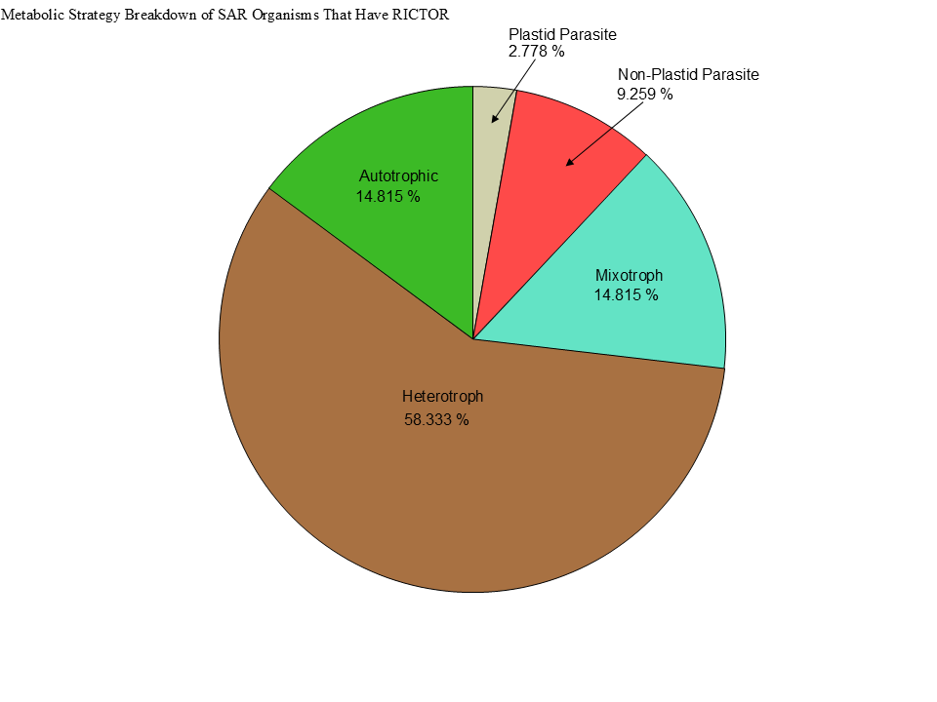
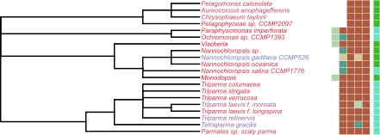
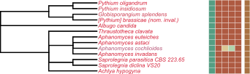
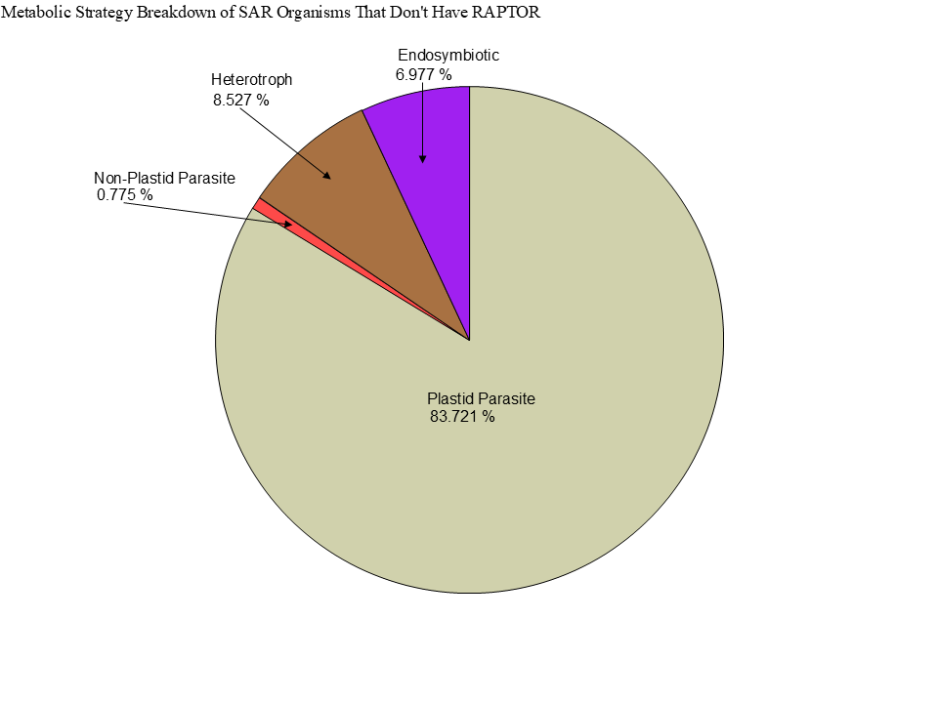
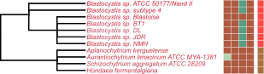
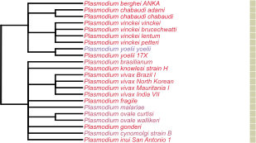

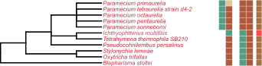
Metabolic Strategy
LST8
RICTOR
RAPTOR
SIN1
TOR
Stramenopiles
Alveolata
Rhizaria

Slide 16


Slide 17


Slide 18




Figure 3
TOR
LST8
RAPTOR
RICTOR
SIN1

Slide 19
Streptophyta
Secondary Endosymbiosis
Rhodophyta
Primary Endosymbiosis
TORC2
Chlorophyta
Chlorarachniales
TORC1 + TORC2
Rhizaria
TORC1 + TORC2
Primary Endosymbiosis
Archaeplastida
TORC1
LECA
TORC1 + TORC2
Paulinella Micropora
TORC1 + TORC2
SAR
TORC1 +TORC2
Secondary Endosymbiosis
TORC2
Stramenopiles TORC1 + TORC2
Brown Algae
TORC1
Secondary Endosymbiosis
Excavates
TORC1 +TORC2
Tertiary Endosymbiosis
TORC2 + TORC1
Eulena Gracilis
TORC1 + TORC2
Alveolata

Slide 20


Figure 7
Metabolic Strategy
SIN1
RICTOR
RAPTOR
LST8
TOR
Discoba
Metamonada

Slide 21



Metabolic Strategy
Streptophyta
SIN1
RICTOR
RAPTOR
LST8
TOR
Rhodophyta
Chlorophyta

Slide 22



Slide 23





Figure 6

Slide 24


Figure 6

Slide 25



Figure 6

Slide 26
Figure 5

Slide 27
Workflow/Pipeline
NCBI/JGI Genomic Information
MSA
Phylogenetic Tree(s)
Results/TOR Complex Patterns
BUSCO/HMMER/BLAST
R Tables & Taxonomy Tables
Graphs/Data Table
SRA /Diamond Alignment
Notes:
We need to add a start point. Have something that asks the question; what organisms have TORC2 Components and TORC1 Components?

Slide 28
SARs Gain of Plastids:
Losses of TOR Complexes
Rhodophyta Endosymbiosis
Phaeodactylum tricornutum
TORC2 Lost
Macrocystis pyrifera
Stramenopila
Nannochloropsis gaditana
Phytophthora sojae
Expected Heterotrophic Ancestor
TORC1 & TORC2 Present
Stramenopile Endosymbiosis
Polarella glaciallis
Vitrella Brassicaformis
Alveolata
Plasmodium falciparum
Tetrahymena thermophila
Alpha-Cyanobacteria Endosymbiosis
Photoautorophy Loss
Paulinella micropora
TORC1 and TORC2 Lost
Bigelowiella natans
TORC1 Lost
Rhizaria
Chlorophyta Endosymbiosis
Plasmodiophora brassicae

Slide 29
Figure 4

Slide 30


Slide 31


Figure 4

Slide 32
Phylo Trees
HMMER
ClustalO
NCBI/JGI
BLAST
Final Images
Patterns of Loss
Dataframe
BUSCO
DIAMOND
Graphs
Metabolism
Literature
Notes:
We need to add a start point. Have something that asks the question; what organisms have TORC2 Components and TORC1 Components?

Slide 33
Simplified Excavata Gain of Plastids
Chlorophyta Endosymbiosis
Euglenophyceae
Discoba
Kinetoplastea
Eutetramitia, etc.
Expected Heterotrophic Ancestor
TORC1 & TORC2 Present
Metamonada

Slide 34


Slide 35

Figure 1
Metamonada
Opisthokonta
Amoebozoa
Discoba
Rhizaria
Streptophyta
Alveolata
Stramenopila
Rhodophyta
Chlorophyta

Slide 36




Figure 7

Slide 37




Slide 38
Figure 3

Slide 39




Slide 40


Slide 41


Slide 42


Slide 43

Figure 3
TOR
LST8
RAPTOR
RICTOR
SIN1

Slide 44








Figure 2

Slide 45
Metabolic Strategy
LST8
RICTOR
RAPTOR
SIN1
TOR
Stramenopiles
Alveolata
Rhizaria

